Slide 1
Wild Beauty:
Postcards from
Mathematical Worlds hosted by Prof. James Propp (UMass Lowell)

Slide 2
"In fact, the pure mathematician may create universes just by writing down an equation, and indeed if he is an individualist he can have a universe of his own."
--- J. J. Thomson

Slide 3
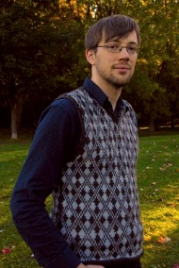
Ben Young

Slide 4
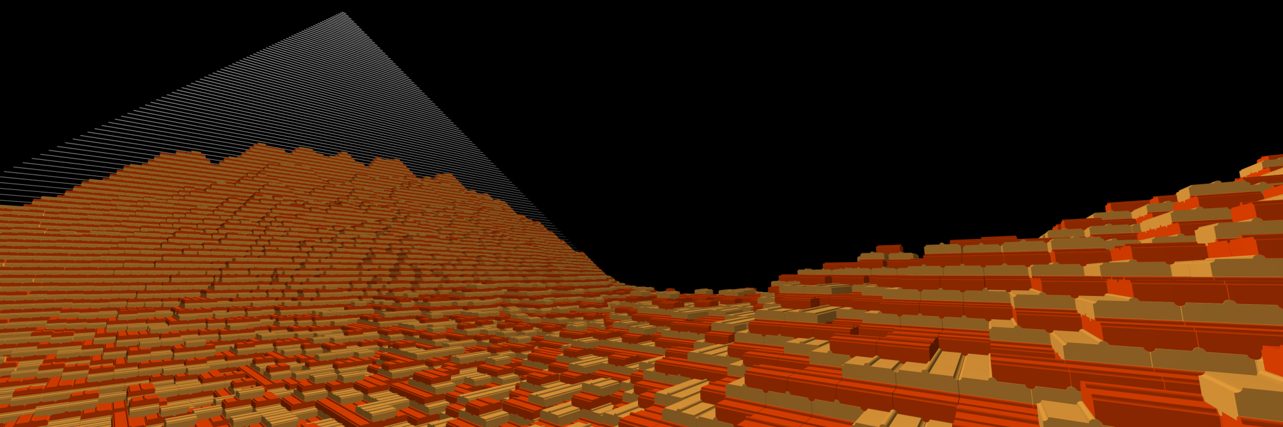

Slide 5
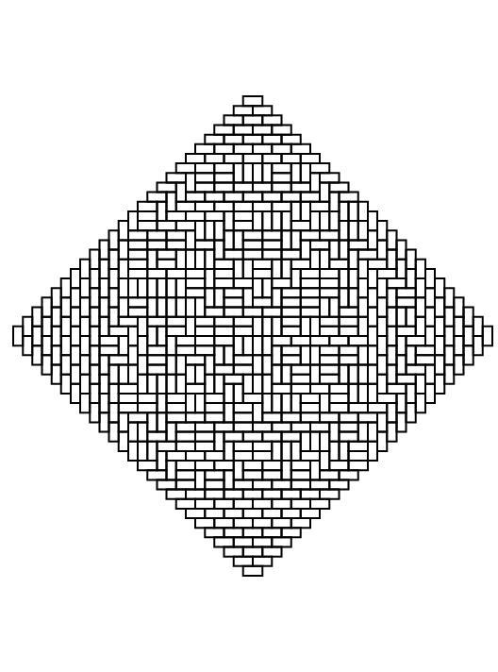
James Propp

Slide 6
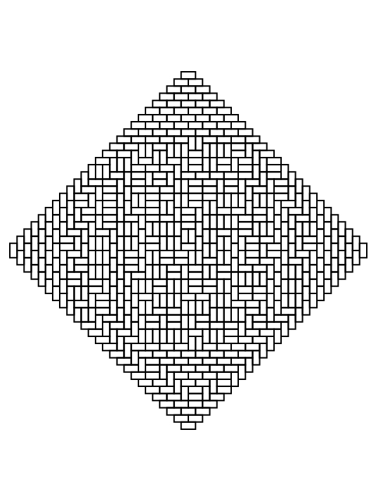
James Propp

Slide 7
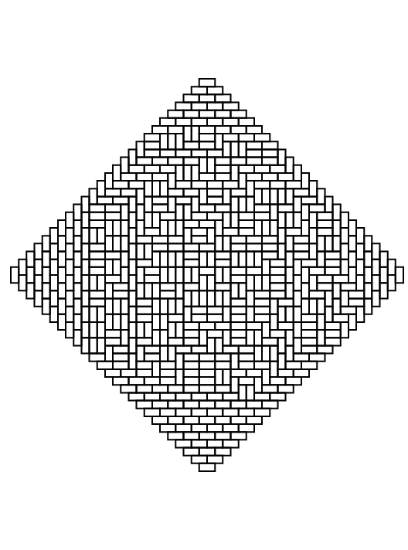
James Propp

Slide 8
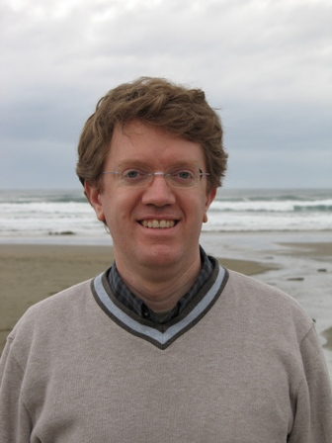
David Wilson

Slide 9
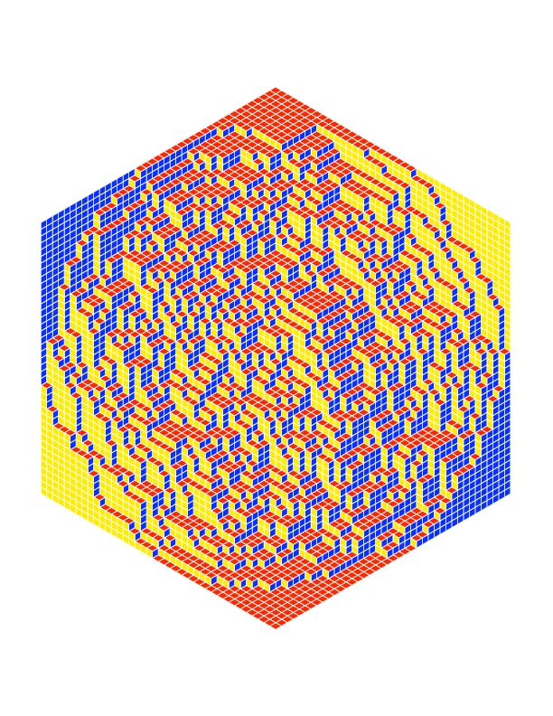

Slide 10
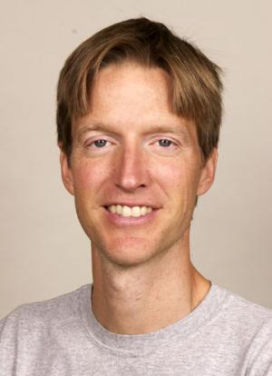
Richard Kenyon

Slide 11
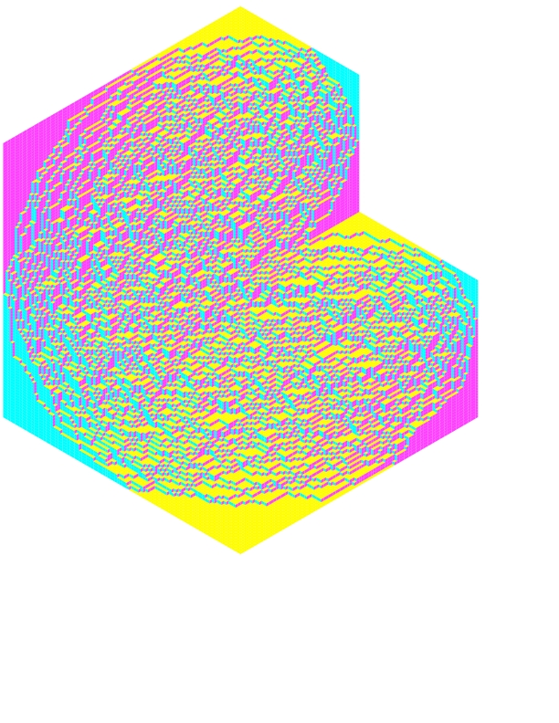

Slide 12
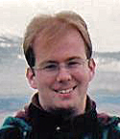
Alexander Holroyd

Slide 13
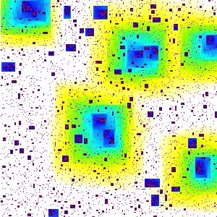

Slide 14
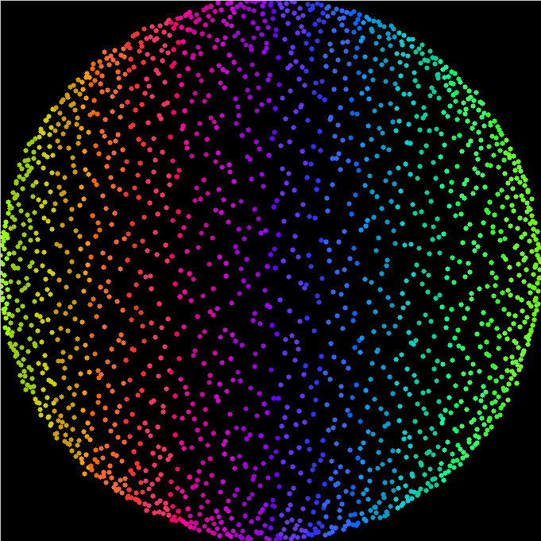

Slide 15
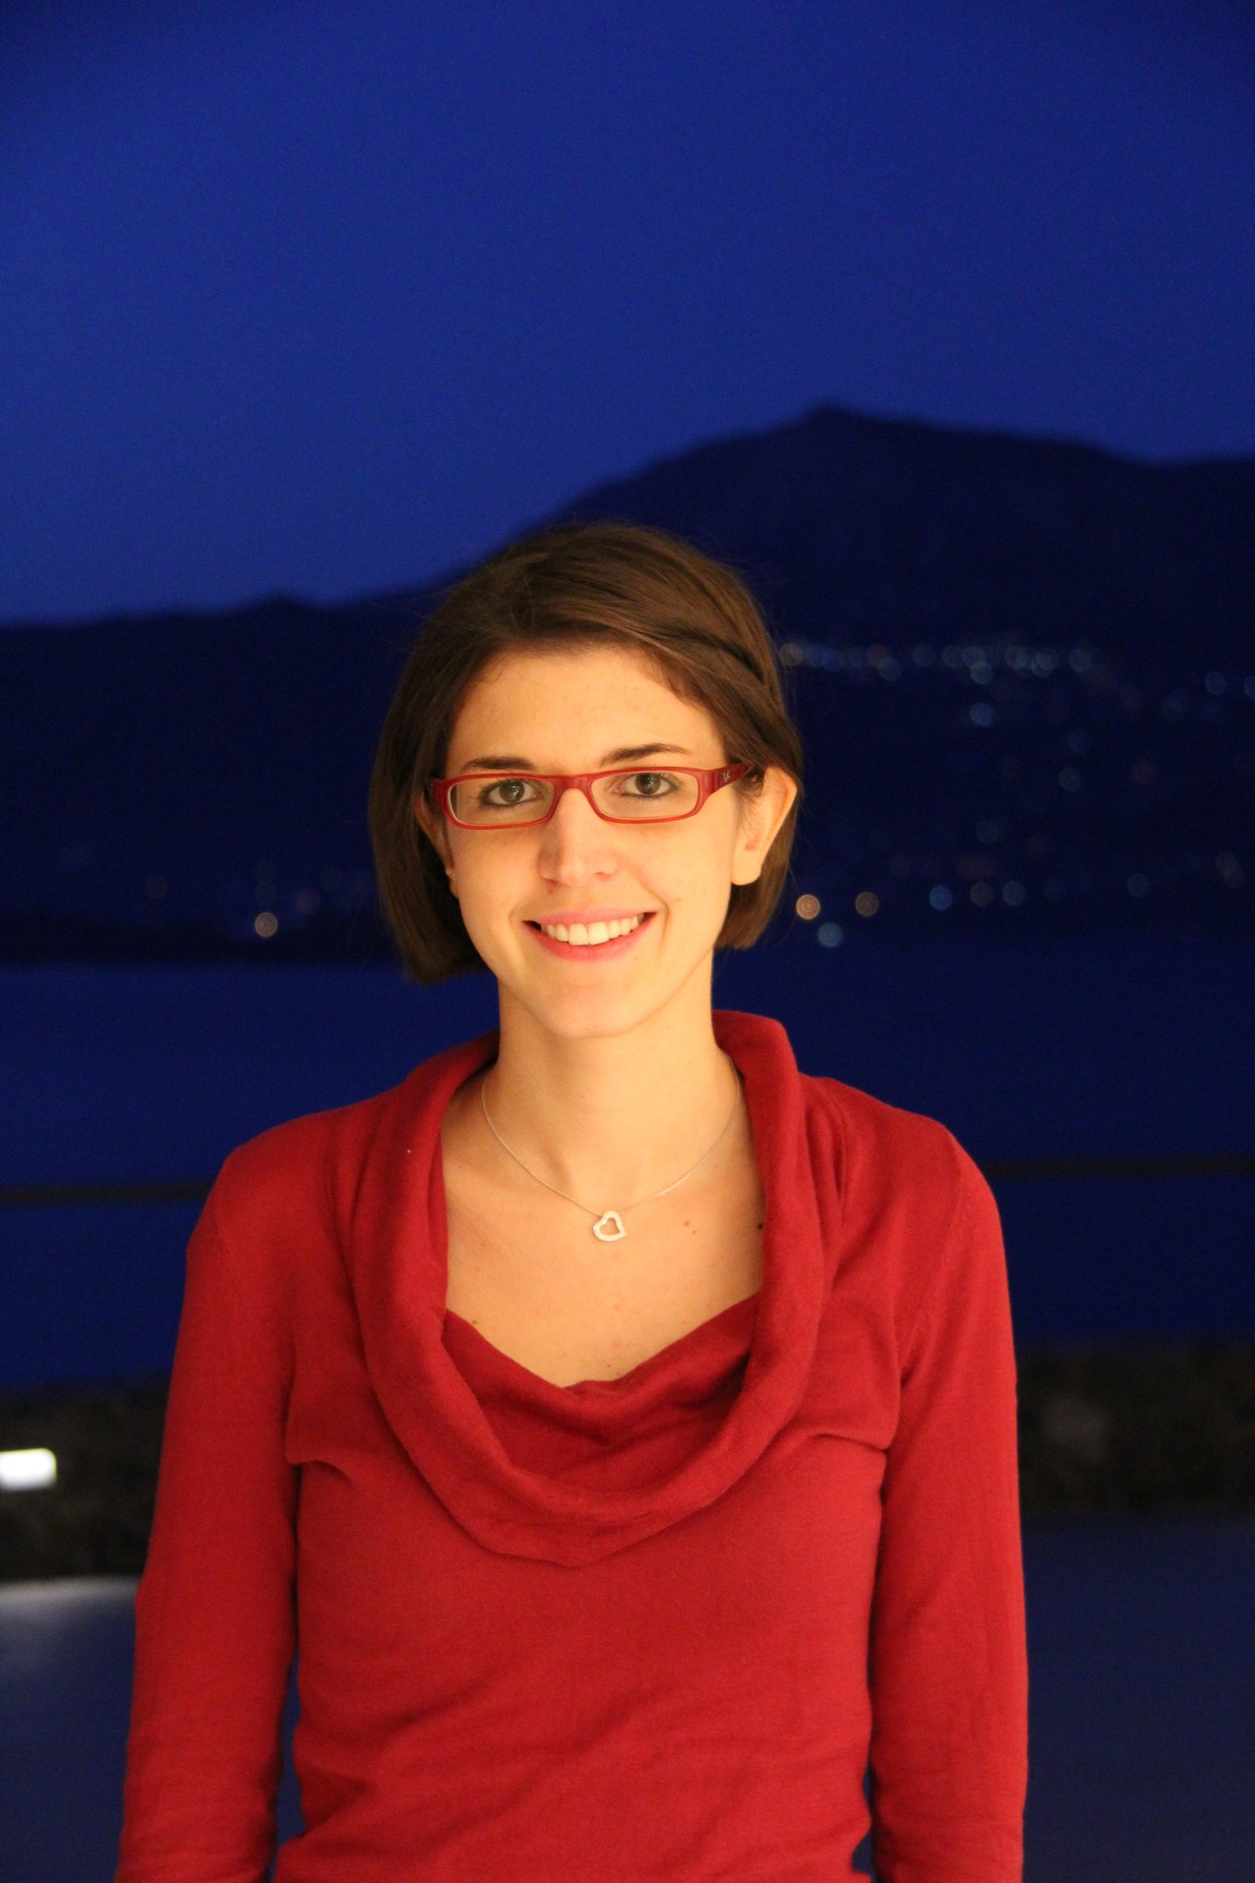
Perla Sousi

Slide 16
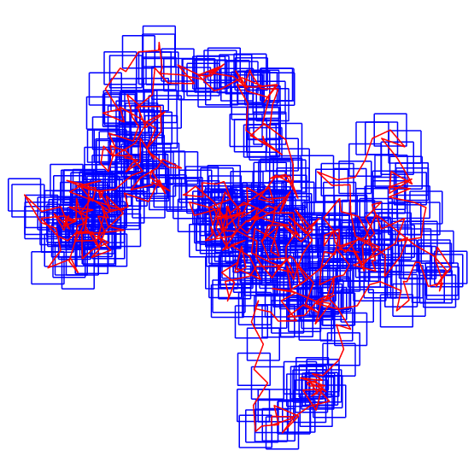

Slide 17
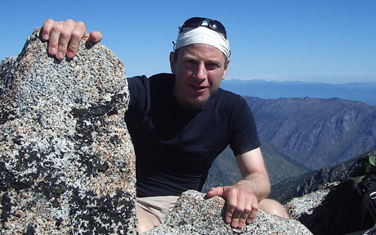
Oded Schramm

Slide 18
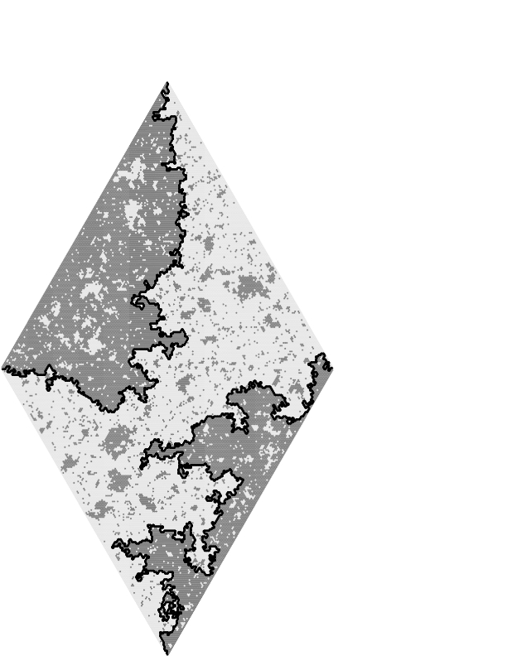
David Wilson

Slide 19
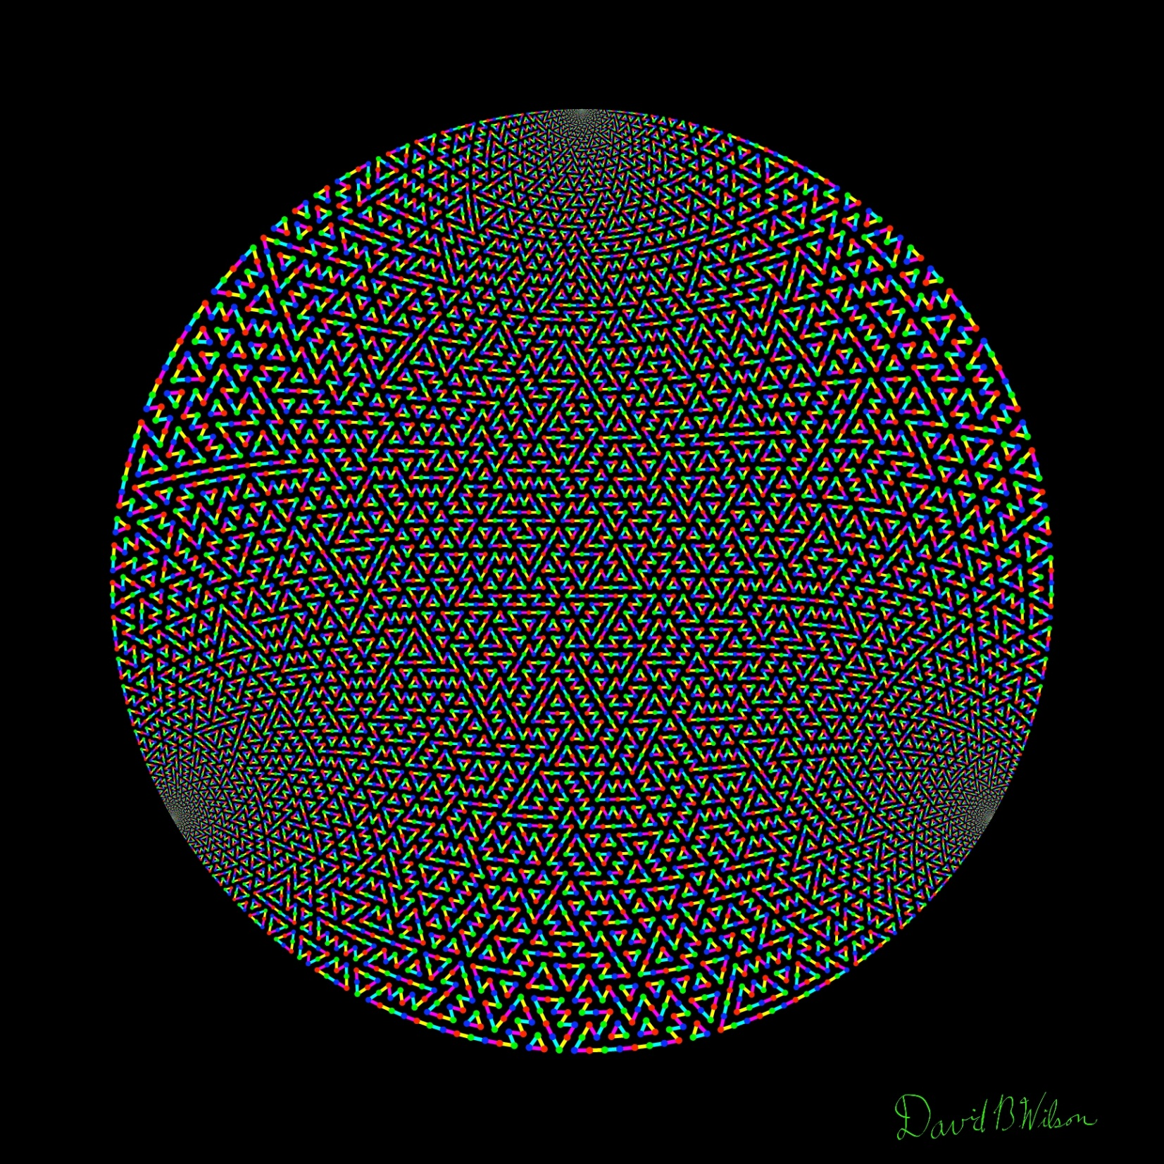

Slide 20
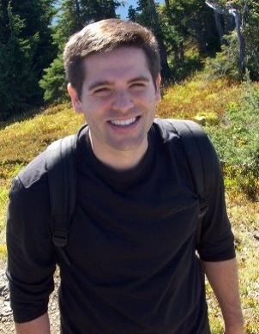
Jason Miller

Slide 21
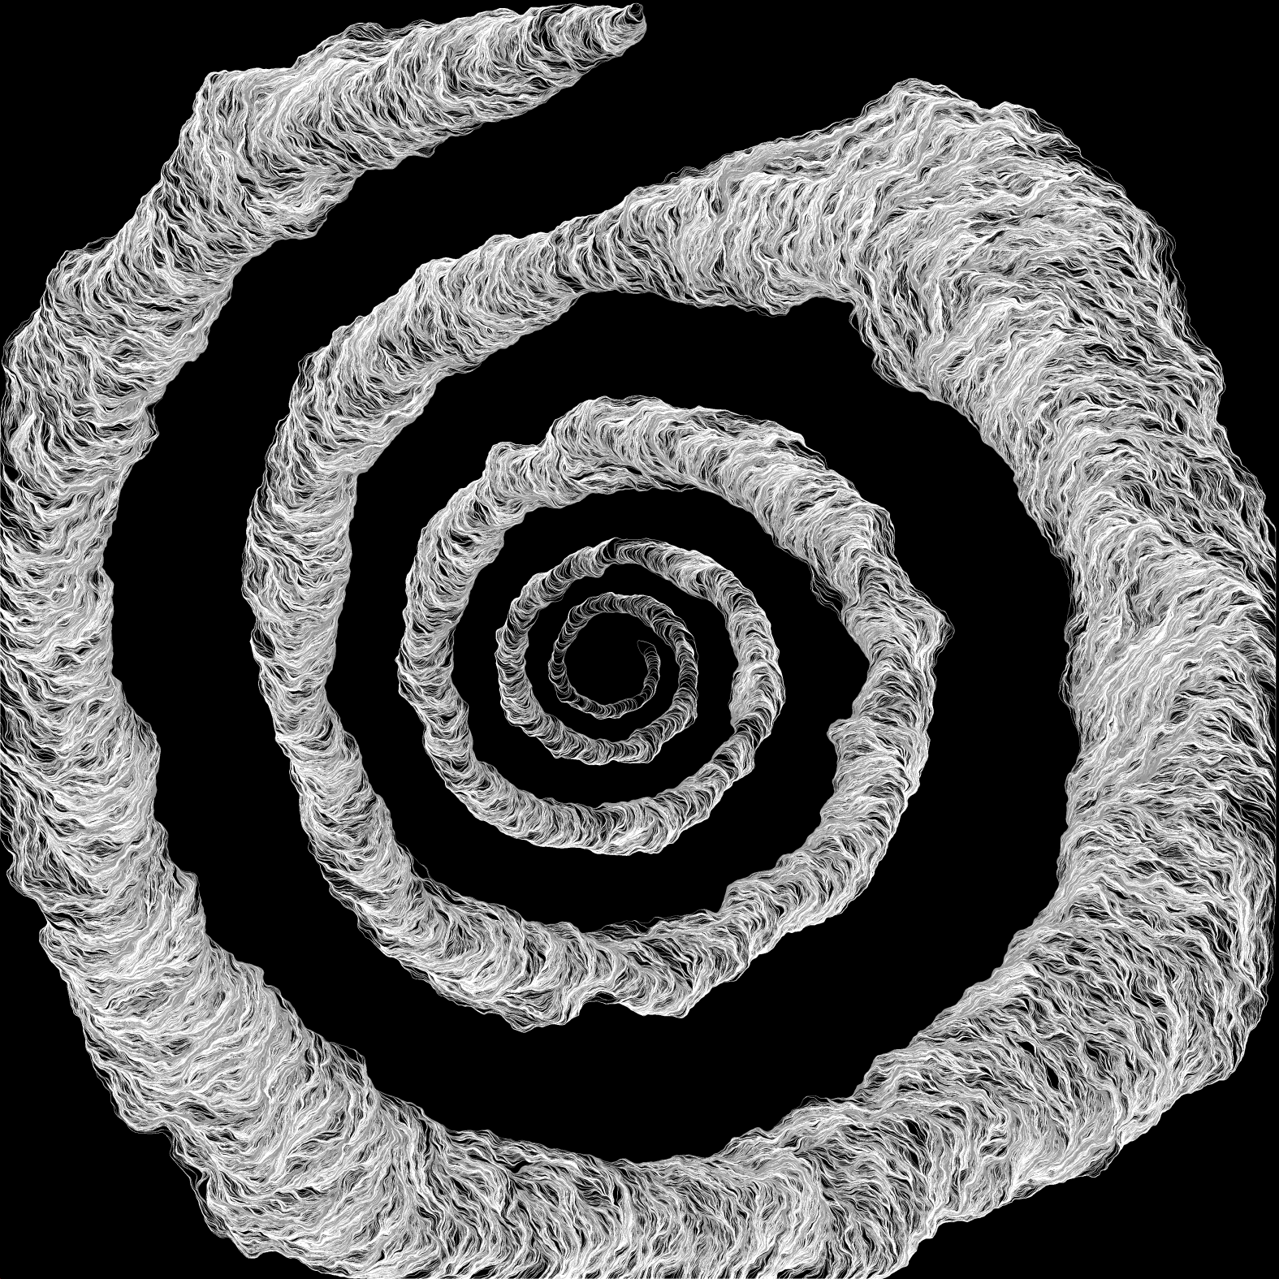

Slide 22
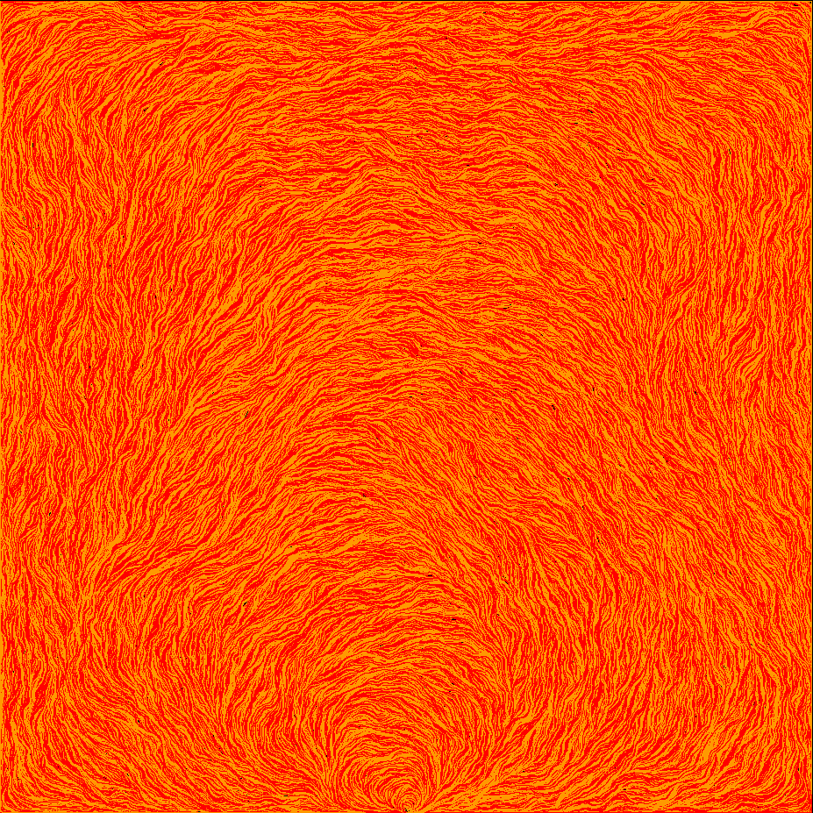

Slide 23
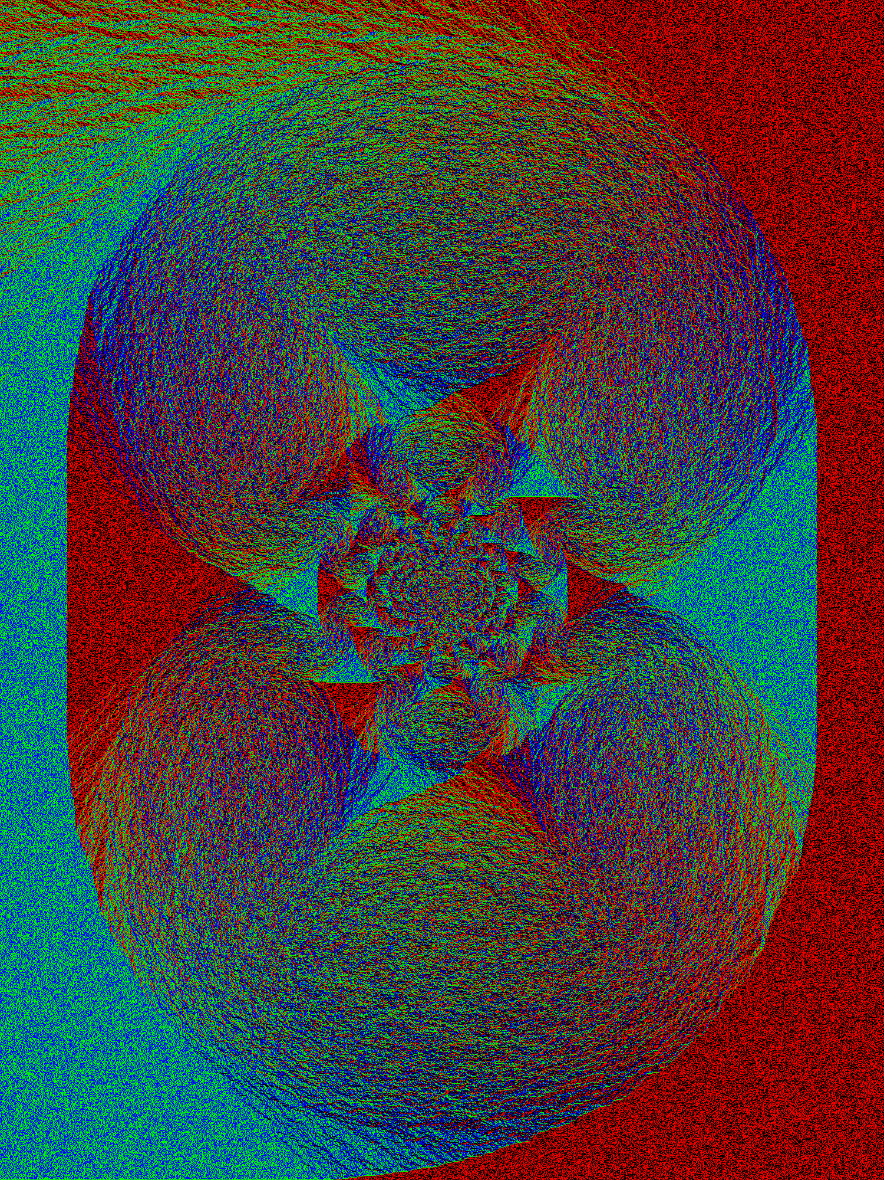
Alexander Holroyd

Slide 24
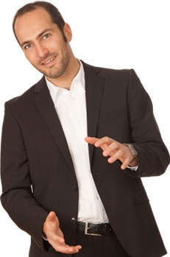
Tobias Friedrich

Slide 25
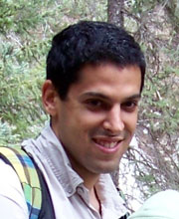
Lionel Levine

