Slide 1
MSRI, February 2021
FLUID-STRUCTURE INTERACTION INVOLVING INCOMPRESSIBLE, VISCOUS FLUIDS
Suncica Canic
Department of Mathematics
UC Berkeley
Alameda/Berkeley, February 2021

Slide 2
PROJECTS (FSI)
FSI Arterial Walls
FSI with STENTs
Micro-robots
Stochastic wave equation and FSI
FSI with poroelastic structures
FSI with Navier slip
FSI with (composite) structures
Self-assembly of active colloidal suspensions
See more
See more
See more
Jeffrey Kuan’s TALK, March 3
TODAY’s TALK
See more
See more
See more

Slide 3
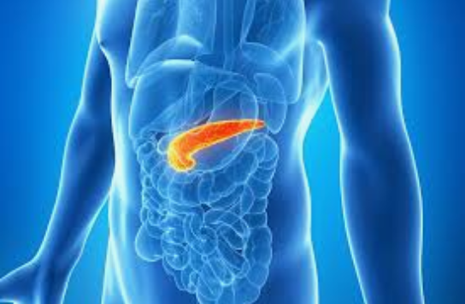
MSRI, February 2021
Interaction between Stokes flow and multi-layered poroelastic medium
Suncica Canic
Department of Mathematics
University of California, Berkeley

Slide 4
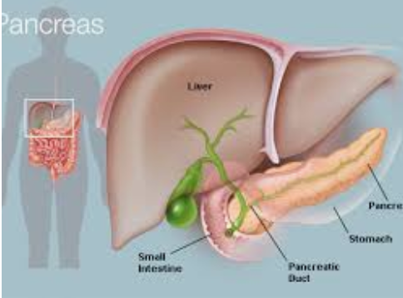
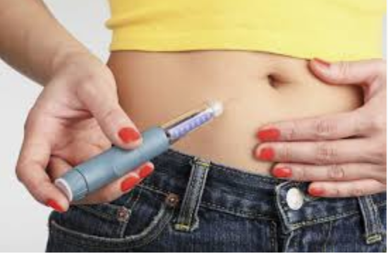
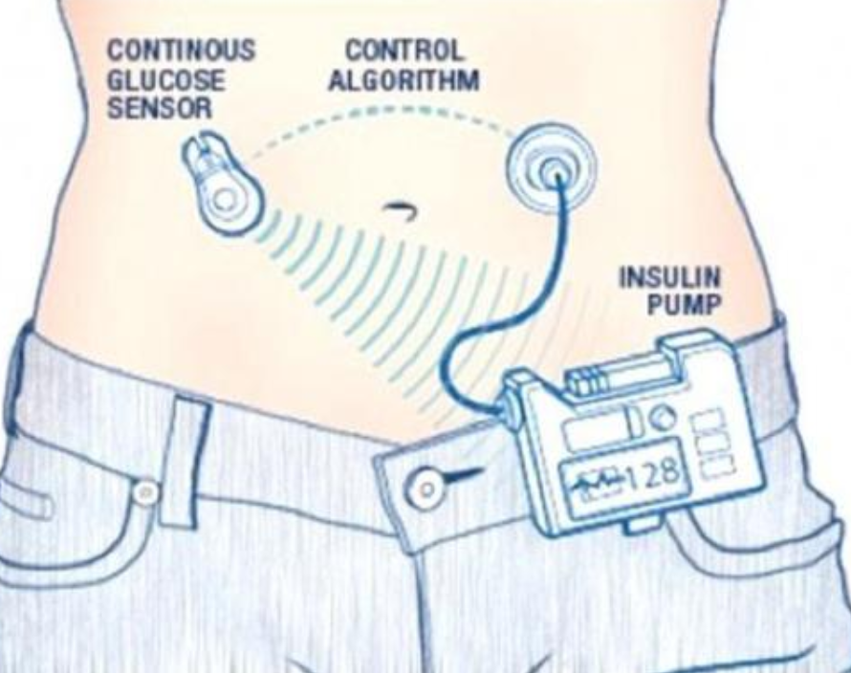
BACKGROUND
Pancreas:
Located between the stomach and the spine
Endocrine function: hormones, including insulin, releasing them into the blood stream to regulate blood sugar levels
Type 1 diabetes:
chronic autoimmune disease
insulin defficiency resulting in hyperglycaemia
one of the most common diseases of childhood (1.25mil in US)
mortality rates 3-18 times higher in Type 1 diabetes patients
Therapy:
insulin replacement therapy via injection or pump
insulin infusion: continuous pump with continuous
sensors (artificial pancreas)
Notes:
Injection: frequent needle sticks (several times a day); hypoglicaemia
Pump: diabetic ketoacidosis (breaking down of fat at a rate that is much too fast, weight gain, pumps are bothersome
Artificial pancreas: disadvantage of not knowing when someone will eat; it bases insulin doses solely on blood glucose levels, which take time to increase after a meal;
burden of wearing and carrying around the different pieces of the artificial pancreas.

Slide 5
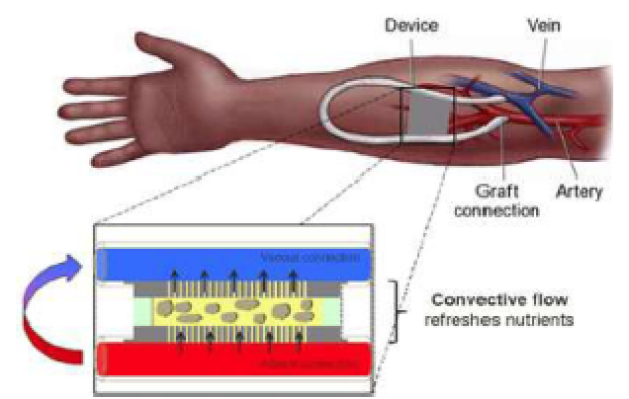
BACKGROUND
Transplantation Therapy:
healty pancreatic cells (islets) from a donor are infused into the liver
once implanted the beta cells in the islets begin to make and release insulin
drawbacks: life-long immunosuppressant therapy (potentially severe side effects)
Implantable bioartificial pancreas*
providing steady insulin supply
when needed
no need for immunosuppressant
therapy
*Shuvo Roy et al., UC San Francisco

Slide 6
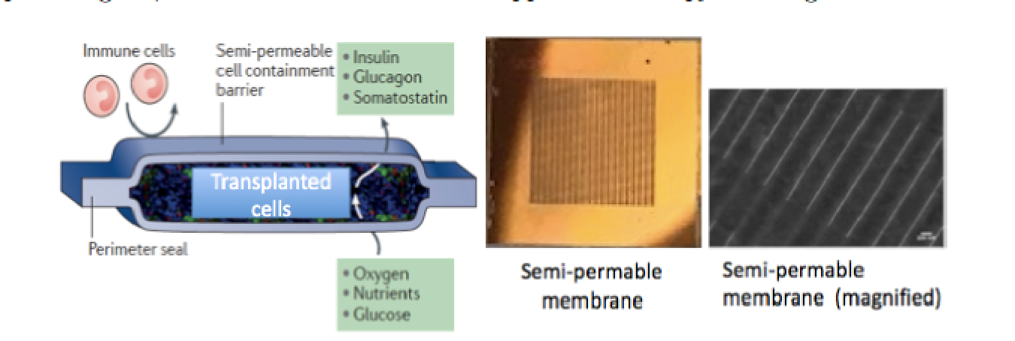
IMPLANTABLE BIOARTIFICIAL PANCREAS
Transplanted islets are embedded in a poroelastic agarose or alginate gel
Two nanopore silicon membranes are used to encapsulate the tissue
The membranes are designed to exclude all cytotoxic cytokines but
allow passage of nutrients and oxygen
10μm
Pore size:
2μm length x 7nm width
*Shuvo Roy et al., UC San Francisco

Slide 7
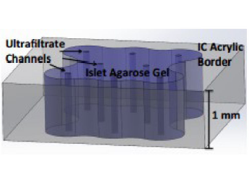
KEY CHALLENGES
Maintaining the survival of transplanted islets for an extended period of time
Sufficient nutrient and oxygen supply
Cell necrosis occurrs if cells are placed more than
150-200 μm away from the nearest blood vessel.
PROPOSED SOLUTIONS
Convective transport based on high pressure gradients
(anastomosis graft)
Ultra-filtrate channels within the poroelastic gel
(islet chamber)
Notes:
Maximize the pore surface area allowing uniform exposure to oxygen while preserving the minimal gel volume containing
islets with sufficient mass to sense blood glucose and secrete insulin.

Slide 8
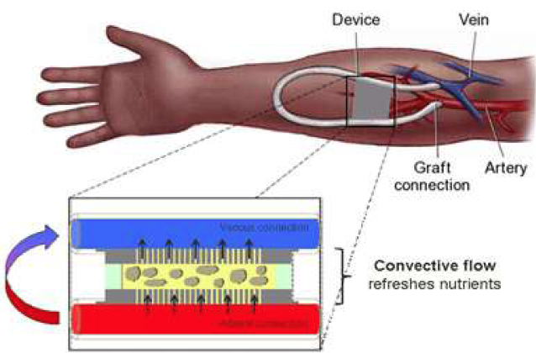
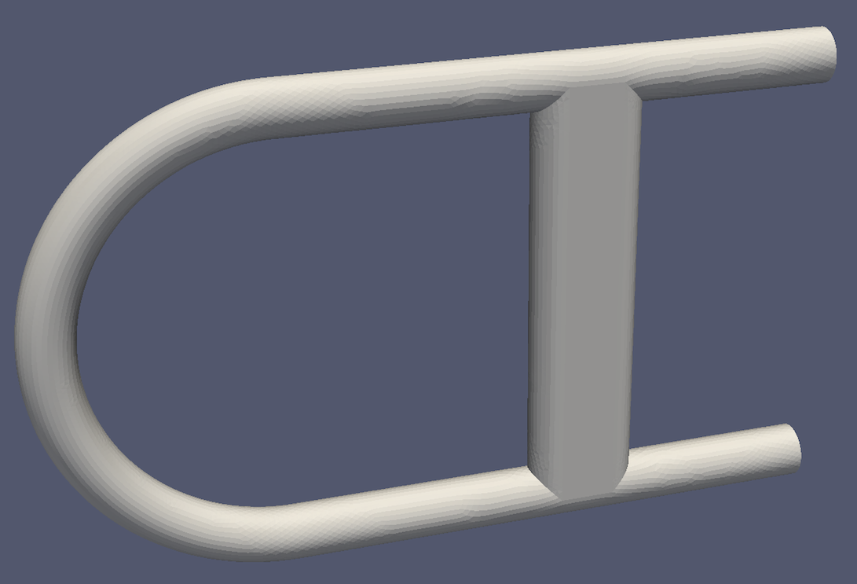
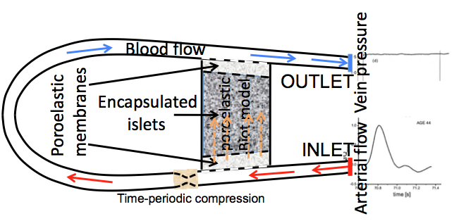
MATHEMATICAL MODELING
COMPUTATIONAL DOMAIN
MULTI-SCALE MODEL
Particle-based simulations
Convolution Neural Networks

Slide 9
MATHEMATICAL MODELING (FLUID-STRUCTURE INTERACTION)
(peristaltic pump)
FLUID-STRUCTURE INTERACTION BETWEEN
BLOOD FLOW AND ANASTOMOSIS GRAFT
FLUID-STRUCTURE INTERACTION BETWEEN
BLOOD FLOW (PLASMA) AND MULTI-LAYERED POROELASTIC STRUCTURE (MEMBRANE/GEL/MEMBRANE)

Slide 10
MATHEMATICAL MODELING (ADVECTION-REACTION-DIFFUSION)
ADVECTION-REACTION-DIFFUSION OF OXYGEN IN TUBULAR GRAFT
ADVECTION-REACTION-DIFFUSION OF OXYGEN IN CELL CHAMBER
ADVECTION-DIFFUSION OF OXYGEN THROUGH SILICON POROELASTIC MEMBRANE

Slide 11
MATHEMATICAL MODELING (FLUID-STRUCTURE INTERACTION)
FLUID-STRUCTURE INTERACTION BETWEEN BLOOD PLASMA AND MULTI-LAYERED POROELASTIC STRUCTURE (MEMBRANE/GEL/MEMBRANE)
Blood flow
Poroelastic gel with
islets
Poroelastic
membrane
Blood flow
Navier-Stokes equations
Darcy law
Biot equations
Darcy law
Poroelastic plate equations

Slide 12
MATHEMATICAL MODELING (FLUID-STRUCTURE INTERACTION)
COUPLING CONDITIONS
HISTORICAL PERSPECTIVE
Blood flow
Poroelastic gel with
islets
Poroelastic
membrane
Free fluid flow
interface
Blood flow
Porous medium
Rigid porous medium
tangential
velocity
COUPLING (boundary) CONDITIONS
Interface
(homogenized)
ACTIVE RESEARCH:
Which of the pressure
coupling conditions gives
rise to a well-posed problem
Sanches-Palencia (1975)
Marciniak and Mikelic(2011)
Saffman(1971)
Beavers-Joseph (1967)

Slide 13
MATHEMATICAL MODELING (FLUID-STRUCTURE INTERACTION)
OUR RESULTS
Poroelastic medium
Moving interface
Blood flow
Poroelastic gel with
islets
COUPLING CONDITIONS
Blood flow
Beavers-Joseph Saffman condition for tangential vel.
+ Continuity of normal vel.
2. Continuity of normal stress
THIS GENERATES A PRESSURE JUMP ACROSS THE INTERFACE, WHICH IS WELL DEFINED VIA THESE COUPLING CONDITIONS!
Elastodynamics driven by jump in normal comp. of normal stress (traction)
Free fluid flow
membrane
Porous medium
Continuity of filtration velocity
Continuity of pressure
With B. Muha, J. Webster, L. Bociu
Notes:
Buckley-Leverett equations for multi-phase flows in porous media (oil, water, surfactact for enhanced oil recovery)

Slide 14
MATHEMATICAL MODELING (FLUID-STRUCTURE INTERACTION)
OUR RESULTS
Poroelastic medium
Moving interface
Blood flow
Poroelastic gel with
islets
COUPLING CONDITIONS
Blood flow
WELL-POSEDNESS?
Beavers-Joseph condition for tangential vel.
+ Continuity of normal vel.
2. Continuity of normal stress
THIS GENERATES A PRESSURE JUMP ACROSS THE INTERFACE, WHICH IS WELL DEFINED VIA THESE COUPLING CONDITIONS!
Elastodynamics driven by jump in normal comp. of normal stress (traction)
Continuity of displacement
Free fluid flow
membrane
Porous medium
Continuity of filtration velocity
Continuity of pressure
With B. Muha, J. Webster, L. Bociu
Notes:
Buckley-Leverett equations for multi-phase flows in porous media (oil, water, surfactact for enhanced oil recovery)

Slide 15
Literature
MODELING (HOMOGENIZATION, ASYMPTOTICS)
Biot (1955,1963), Detournay and H-D Cheng. Fundamentals of poroelasticity (1993), T. Levy and E. Sanchez-Palencia (1975), J-LAuriault (1997), W.Jager and A. Mikelic (1996, 2000), A. Marciniak-Czochra and A. Mikelic (2015), Coussy, Poromechanics (2004)
WELL-POSENDESS OF BIOT SYSTEM ALONE
Zenisek (1984), R.E.Showalter (1996, 2000, 2005), N. Su and R.E.Showalter (2001), H. Barucq, M.
Madaune-Tort, P. Saint-Macary (2004&2005), S. Owczarek(2010), L. Bociu, G. Guidoboni, R. Sacco,
and J. T. Webster (2016), Y.Cao, S. Chen, and A.J. Meir (2013) (uniqueness for quasistatic case?)
FSI WITH POROUS MEDIA (STOKES-DARCY)
Beavers and Joseph (1967), Saffman (1971), Jaeger-Mikelic (1996,2000), Anna Marciniak-Czochra and Andro Mikelic (2015), Jones (1974), M. LeBars and M.G.Worster (2006), L.E. Payne and B. Straughan (1998), M. Discacciati and A. Quarteroni (2009)-review theory, numerics; Navier-Stokes-Darcy coupling,W.L. Layton, F. Schieweck, and I. Yotov (2003), Cao, Gunzburger, Hua, Wang (2010)
FSI WITH POROELASTIC MEDIA (LINEARIZED INTERFACE)
R. E. Showalter (2005), A. Cesmelioglu (2017), Ambartsumyan, Ervin, Nguyen, and Ivan Yotov (2019), L. Bociu, S. Canic, B. Muha, J. Webster (2020)
Notes:
Shawalter: Compressible Stokes coupled to Biot; semi-group approach on variational formulation; the incompressible Stokes does not seem to be covered by this analysis;
Cesmelioglu (2017): Incompressible Navier-Stokes and Biot coupled over fixed interface; existence of strong solutions under smallness of data assumption;
Yotov et al. (2020): Stationary Non-Newtonian fluid coupled with Biot via fixed interface;
Our novelites: Nonlinear Biot, Multi-Layered poroelastic structure; Novel Poroelastic Plate model; Incompressible Time-dependent Stokes; Constructive Existence Proof

Slide 16
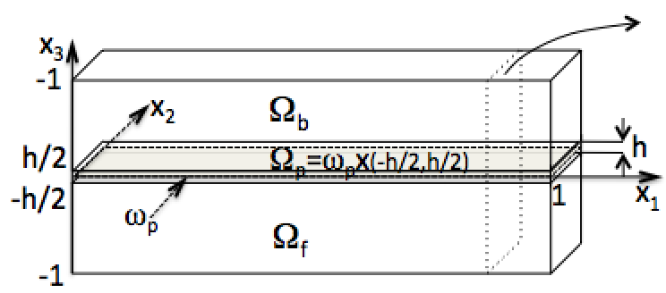
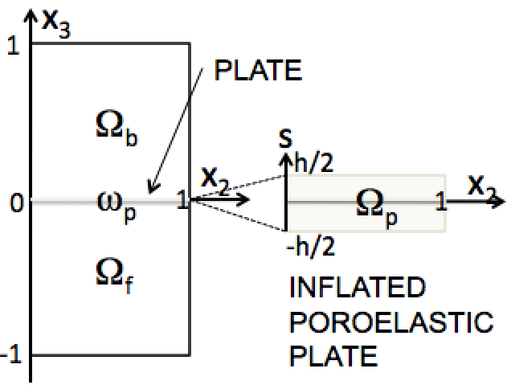
The model equations
BIOT
BIOT
BIOT
PLATE
FLUID
FLUID
FLUID
BIOT MODEL

Slide 17
The model equations
BIOT
BIOT
BIOT
PLATE
FLUID
FLUID
FLUID
BIOT MODEL
Notes:
Biot-Willis parameter account for the couping strength between the fluid and the poroelastic matrix.

Slide 18
The model equations
BIOT
BIOT
BIOT
PLATE
FLUID
FLUID
FLUID
BIOT MODEL
LINEAR AND NONLINEAR PERMEABILITY (stent problem)

Slide 19
The model equations
BIOT
BIOT
BIOT
PLATE
FLUID
FLUID
FLUID
POROELASTIC PLATE MODEL
Biot (1955)
Marciniak-Czochra&Mikelic(2014)

Slide 20
The model equations
BIOT
BIOT
BIOT
PLATE
FLUID
FLUID
FLUID
FREE FLUID-time dependent Stokes

Slide 21
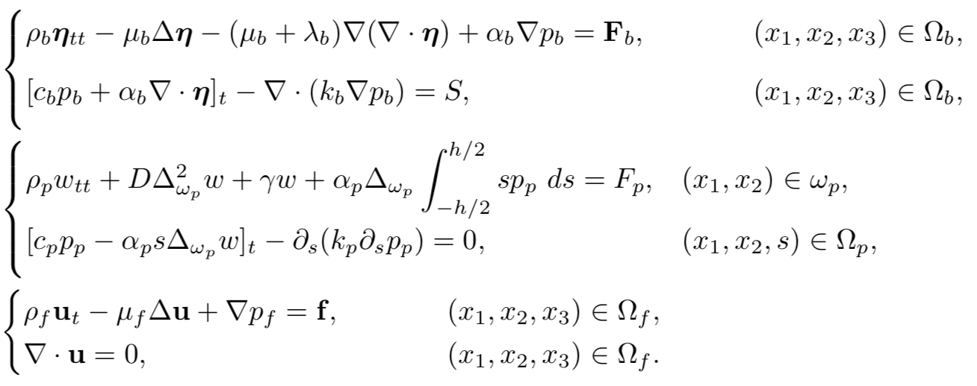
The model equations: Summary
BIOT
BIOT
BIOT
PLATE
FLUID
FLUID
FLUID

Slide 22
Coupling Conditions
TOP SURFACE
ω_{p}⁺
BIOT
MIDDLE
SURFACE
ω_{p}
PLATE
BOTTOM SURFACE
ω_{p}⁻
FLUID
MIDDLE SURFACE ω_{p}

Slide 23
Coupling Conditions
TOP SURFACE
ω_{p}⁺
BIOT
MIDDLE
SURFACE
ω_{p}
PLATE
BOTTOM SURFACE
ω_{p}⁻
FLUID
TOP SURFACE ω_{p}⁺
BOTTOM SURFACE ω_{p}⁻

Slide 24
Coupling Conditions
TOP SURFACE
ω_{p}⁺
BIOT
MIDDLE
SURFACE
ω_{p}
PLATE
BOTTOM SURFACE
ω_{p}⁻
FLUID
TOP SURFACE ω_{p}⁺
PRESSURE JUMP ACROSS
INTERFACE
BOTTOM SURFACE ω_{p}⁻

Slide 25
ENERGY ESTIMATE
where:

Slide 26
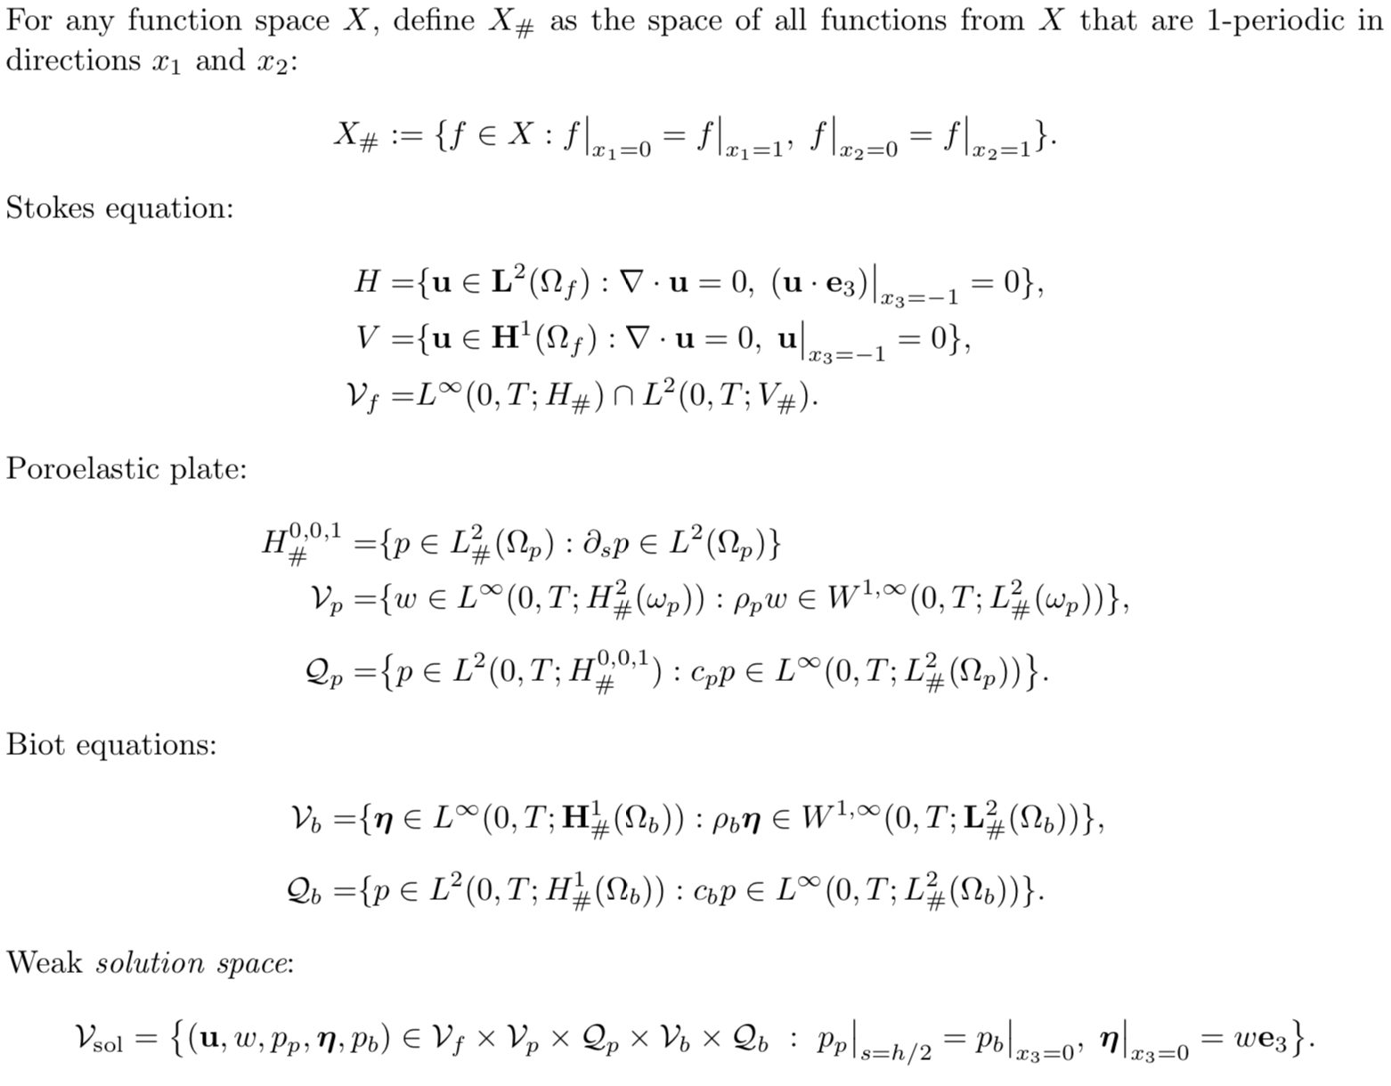
FUNCTION SPACES

Slide 27
Main results
with L. Bociu, B. Muha and J. Webster (2020)
Linear problem (existence):
(Proof based on semi-discretization in time (Rothe’s method), and energy estimates alla Muha and Canic (2013))
Linear problem (uniqueness):
Notes:
Linear uniqueness is a problem only for the quasi-static case when the inertial of the elastodynamics equation is zero (\rho_b = 0). In that case the “usual” test function $\eta_t$ is not necessarily in $L^2$ (because there is no second-order derivative with respect ot time in the elastodynamics equation). Also, Uniqueness is complicated by the fact that we constructed a weak solution using energy estimates, which hold for the particularly constructed weak solution. Thus, not all weak solutions need satisfy the energy estimates that are used to prove uniqueness. It is known, in general, that this is a problem for the Biot system since the time derivative of the displacement of the poroelastic matrix, which would be used to multiply the first equation in the Biot system to get energy, may not have enough regularity for integration by parts to hold. Thus we needed an additional property on weak solutions under which we get uniqueness.
Even in the non-quasi-static case, the way how we obtain our energy estimates via time-discretization, the meaning of \eta_t is lost. Only in the limit, as delta t goes to zero, we get the limiting energy estimate,
Which holds for our particularly constructed solution. It is not, a priori clear, that all weak solutions will satisfy that estimate, since there may be other solutions, constructed differently, that do not satisfy it. That is the reason
Why we had to assume that additional energy estimte conditions for uniqueness. So, our solution is unique in the class of energy solutions only.
Why quasistatic case for nonlinear problem: for compactness we needed additional (elliptic) regularity for structure displacements.

Slide 28
Main results
with L. Bociu, B. Muha and J. Webster (2020)
Nonlinear problem (existence):
(Proof using a compactness result by Drehel and Jüngel (2012))
(Crucial: presence of poroelastic plate – regularizing mechanism)
Show proof
Nonlinear problem (strong-weak uniqueness for mild solutions):
Notes:
At the moment, even for the nonlinear Biot system alone, a full uniqueness result does not exist in literature.
We needed an additional assumption on the regularity of the Biot pressure.

Slide 29
NUMERICAL SIMULATIONS
MULTI-SCALE SIMULATION
NANO-SCALE (pore scale) MACRO-SCALE (organ scale)
FILTRATION (SEEPAGE) VELOCITY
VASCULAR GRAFT
ISLET CHAMBER
SEMI-PERMEABLE
MEMBRANES
ISLET CHAMBER
HYDRAULIC CONDUCTIVITY COEFFICIENT
VERTICAL DIRECTION
PRESSURE
SPH (Smoothed Particle Hydro-
dynamics) simulations at nano-scale
Convolution Neural Networks (CNN)
LOCAL HYDRAULIC CONDUCTIVITY IN
ISLET CHAMBER USING CNN
Input: geometry of the gel poroelastic matrix
train the CNN over a larget set of synthetic and
imaging data
output : local hydraulic permeability tensor
coefficients
Finite Element Method-based solvers
Implemented within FEniCS parallel platform
Parallelization on GPU node Salvio
cluster at UCB
Bukač, Martina, Ivan Yotov, Rana Zakerzadeh, and Paolo Zunino. ”Partitioning strategies for the
interaction of a fluid with a poroelastic material based on a Nitsche’s coupling approach.”
Computer Methods in Applied Mechanics and Engineering 292 (2015):138-170.
Notes:
Monolithic method, with Nitche’s coupling (penalty), and loosely coupled scheme used as a preconditioner.

Slide 30
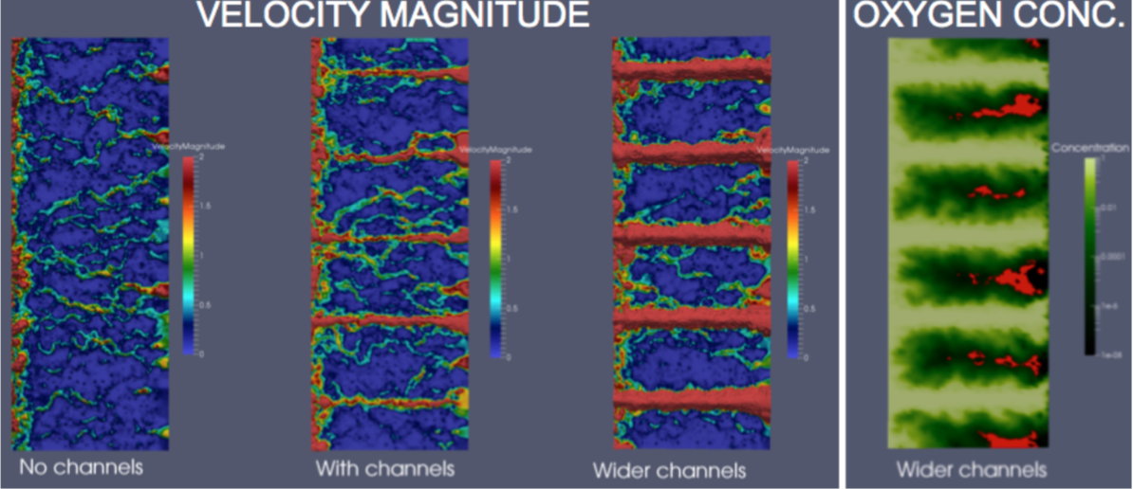
NUMERICAL RESULTS with Yifan Wang
Ultra-filtration channels within islet chamber increase oxygen supply to the islets;
The number and location of ultra-filtration channels needs to be designed with the constraint of preserving the minimal gel volume containing the islets with sufficient mass to sense blood glucose and secrete insulin.

Slide 31
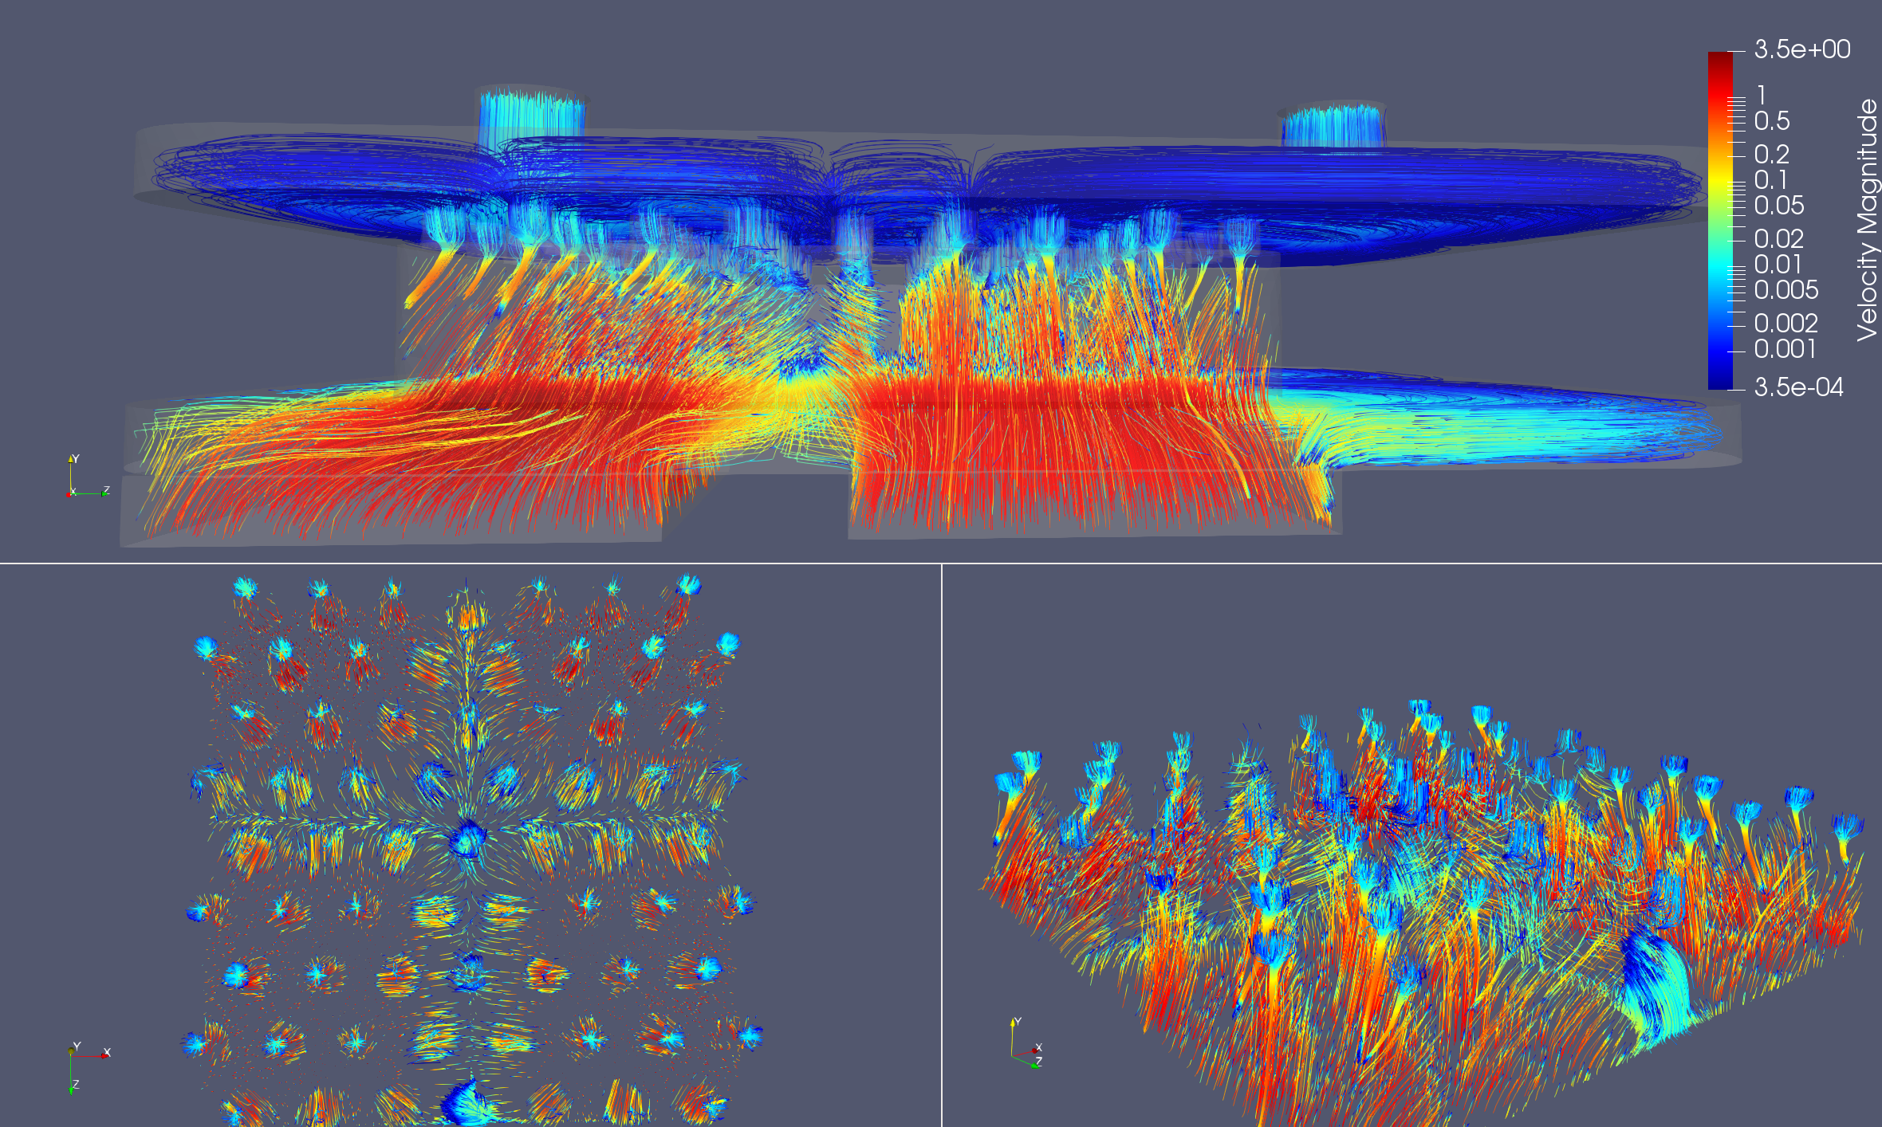
NUMERICAL RESULTS (Gen II)
Two outlets are better than one
Anastomosis graft
Gasket
Outlet chanels
Islet chamber
Gasket
membrane
membrane
Anastomosis graft
VELOCITY STREAMLINES IN GENERATION II PANCREAS DESIGN
membrane

Slide 32
NUMERICAL RESULTS
OXYGEN CONCENTRATION
membrane

Slide 33
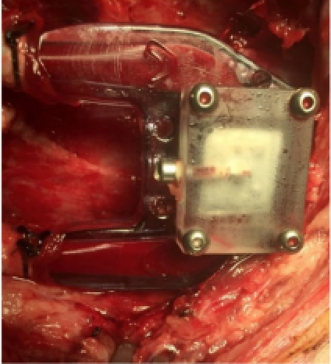
Porcine model
An INTRAVASCULAR BIOARTIFICIAL PANCREAS by Song et al. Roy.

Slide 34
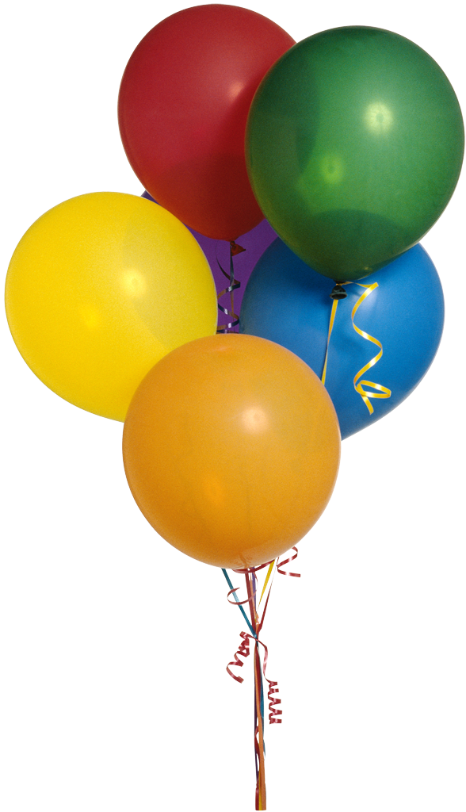
NEXT
STOCHASTIC EFFECTS
Stochastic wave equation and FSI
Jeffrey Kuan’s TALK, March 3

Slide 35
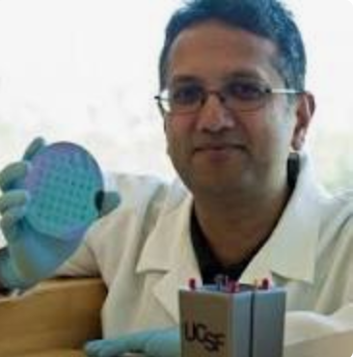
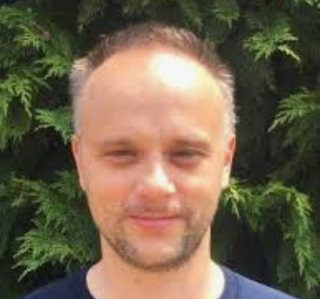
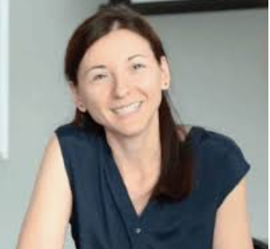
THANKS
Shuvo Roy (UCSF)
Yifan Wang (UCI)
Boris Muha (U Zagreb)
Irena Bociu (NCSU)
Justin Webster (Maryland BC)

Slide 36
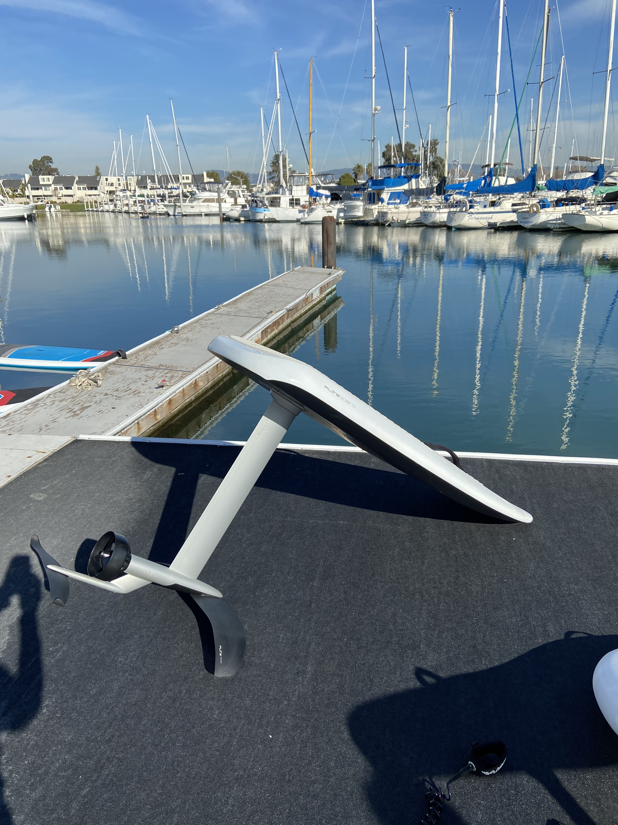
E-Foil
e-Foil

Slide 38
MATHEMATICAL MODELING (ADVECTION-REACTION-DIFFUSION)
ADVECTION-REACTION-DIFFUSION OF OXYGEN IN CELL CHAMBER
Heaviside step-down
1
c_{r}
c

Slide 39
MAIN RESULTS
5. Taking into account poroelasticity in the modeling is important.
DISPLACEMENT

