Slide 1
Recitation 3
Revenue Maximization

Slide 2
Part 1 – Single-Parameter Environment

Slide 3
Part 1 Outline
Solutions for yesterday’s problems
The prophet inequality
Including an application to revenue maximization
The Bulow-Klemperer theorem

Slide 4
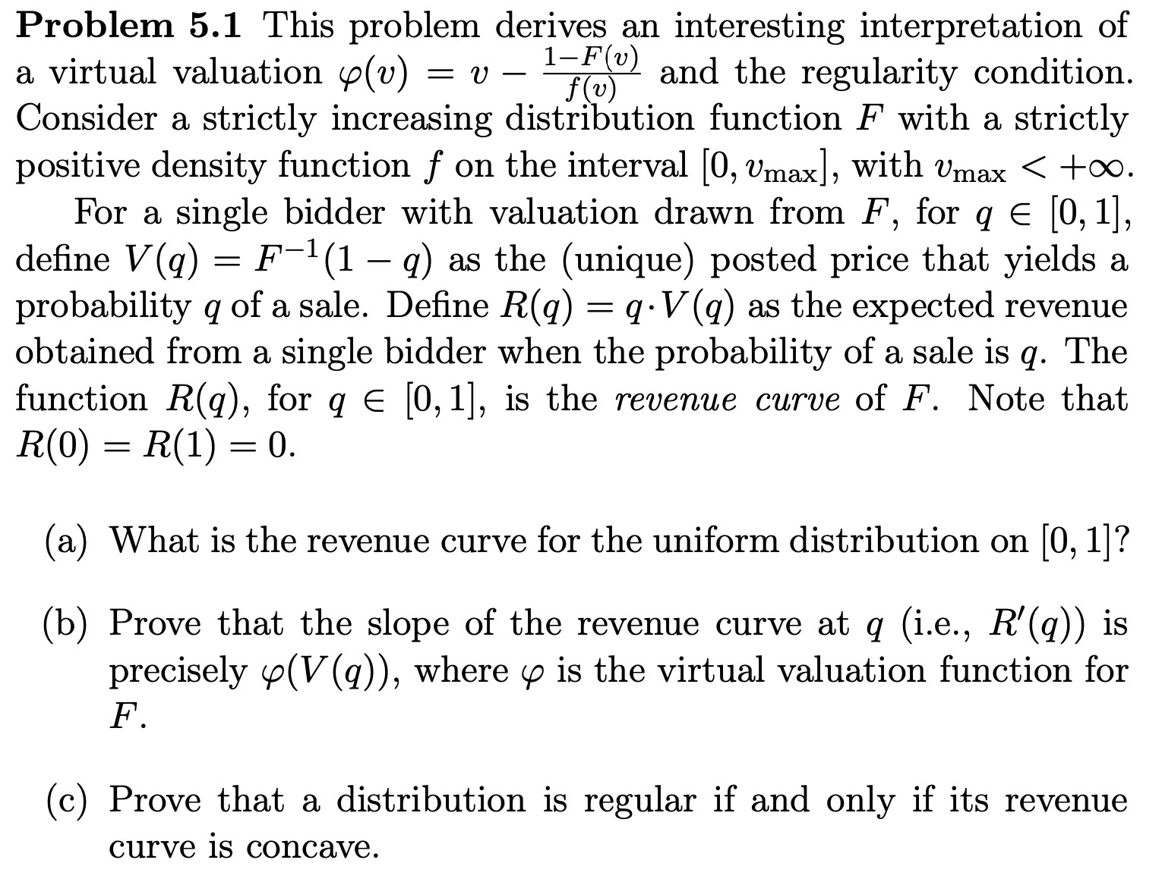
Yesterday’s Problems

Slide 5
Pr. 5.1(a)
$F\left(q\right)≡q$.
$F^{−1}\left(q\right)≡q$.
${V\left(q\right)=F}^{−1}\left(1−q\right)=1−q$.
$R\left(q\right)=qV\left(q\right)=q\left(1−q\right)$.

Slide 6
Pr. 5.1(b)
$R^{′}\left(q\right)=V\left(q\right)+qV^{′}\left(q\right)=_{{V\left(q\right)=F}^{−1}\left(1−q\right)}V\left(q\right)+\frac{q}{f\left(F^{−1}\left(1−q\right)\right)}⋅\left(−1\right)=V\left(q\right)−\frac{1−F\left(F^{−1}\left(1−q\right)\right)}{f\left(V\left(q\right)\right)}=V\left(q\right)−\frac{1−F\left(V\left(q\right)\right)}{f\left(V\left(q\right)\right)}=φ\left(V\left(q\right)\right)$.
We used the inverse function theorem.

Slide 7
Pr. 5.1(c)
$R$ is concave iff $R^{′}\left(q\right)=φ\left(V\left(q\right)\right)$ is non-increasing as a function of $q$.
$F$ is regular iff $φ\left(v\right)$ is non-decreasing as a function of $v$.
1-1 correspondence between $q∈[0,1]$ and $V\left(q\right)∈[0,v_{max}]$.
When $q$ goes over all the values from $0$ to $1$, $V\left(q\right)$ goes over all the values from $v_{max}$ to $0$.

Slide 8
Yesterday’s Problems

Slide 9
Pr. 5.2
We have to prove: $R\left(\frac{1}{2}\right)≥\frac{1}{2}R\left(q^{∗}\right)$ for an optimal $q^{∗}$.
$R$ is concave by Pr. 5.1(c) and is non-negative.
Thus, $R\left(\frac{1}{2}\right)=R\left(\frac{1}{2}q^{∗}+\frac{1}{2}\left(1−q^{∗}\right)\right)≥\frac{1}{2}R\left(q^{∗}\right)+\frac{1}{2}R\left(1−q^{∗}\right)≥\frac{1}{2}R\left(q^{∗}\right)$.

Slide 10
Questions?

Slide 11
Revenue Maximization
$n$ bidders with regular distributions $F_{1},…,F_{n}$ of valuations (drawn independently).
Assume $F_{1},…,F_{n}$ have bounded support and are strictly increasing.
What is the revenue-maximizing DSIC auction?
Award the item to the bidder with the highest virtual valuation, provided that it is nonnegative.
Charge the winner her critical bid.

Slide 12
Prophet Inequality
$n$ stages.
Prizes $π_{1}∼G_{1},π_{2}∼G_{2},…,π_{n}∼G_{n}$ are drawn independently, sequentially.
The distributions $G_{1},…,G_{n}$ are known in advance.
At some stage, you should stop drawing and take the current prize.

Slide 13
Prophet Inequality
It holds even under adversarial tiebreaking.

Slide 14
Approximate Revenue Maximization
Rem.: Expected revenue equals expected virtual welfare.
Set $π_{i}=φ_{i}{\left(v_{i}\right)}^{+}≔\max\left\{0,φ_{i}\left(v_{i}\right)\right\}$.
The expected revenue:

Slide 15
Approximate Revenue Maximization

Slide 16
2nd Price Auction with Bidder-Specific Reserves

Slide 17
Questions?

Slide 18
Prior-Independent Auctions
Is it reasonable to assume that the allocation depends on the valuations’ distributions?
Wilson’s critique
“I foresee the progress of game theory as depending on successive reductions in the base of common knowledge required to conduct useful analyses of practical problems. Only by repeated weakening of common knowledge assumptions will the theory approximate reality.”

Slide 19
Revenue Maximization
Is optimizing the mechanism format that important?
What about increasing the competition?

Slide 20
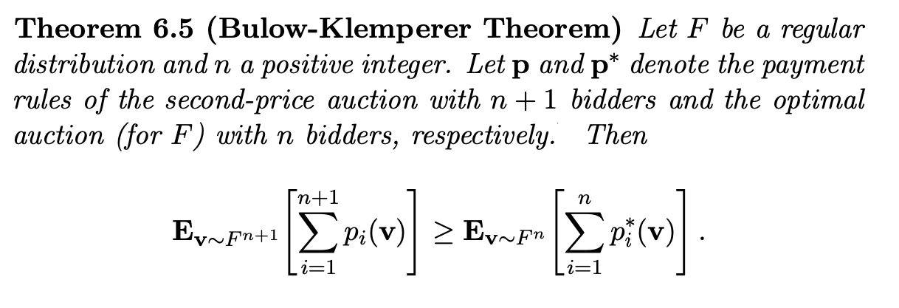
The Bulow-Klemperer Theorem

Slide 21
Proof Sketch
When valuation are drawn i.i.d. from a regular distribution, the 2nd price auction maximizes expected revenue among all the auctions that always allocate the item.
Since it maximizes expected virtual welfare among them.
RHS is the revenue of a certain $\left(n+1\right)$-bidder auction $A$.

Slide 22
Proof Sketch

Slide 23
Questions?

Slide 24
Part 2 – Selling Two Items Separately – Left for Tomorrow

Slide 25
Enjoy The Tea Break!

