Slide 1



Chern Simons Theory and Fracton
Xiuqi Ma
Wilbur Shirley
Meng Cheng
Michael Levin
John McGreevy
Hotat Lam
arXiv:2010.08917
Xie Chen, Caltech
Nov 2021

Slide 2
Topological Order – Toric Code
Z
X
Z
Z
Z
Z
X
Z
X
X
X
X
Z
X
X
Z
All terms commute
Periodic boundary condition, two torus
Ground State Degeneracy
Z
X
Z
Z
X
X
Z
X

Slide 3
Topological Order – Toric Code
Z
Z
Z
Z
Z
Z
X
X
X
X
X
X
X
Z
X
Z
Z
X
Z
Z
X
X
Z
X
braiding statistics

Slide 4
Fracton: X-cube model
Cubic lattice
Ground State Degeneracy
Vijay, Haah, Fu, 16

Slide 5
X-cube model: excitation
Lineon excitations:
X
X
X
X
X

Slide 6
X-cube model: excitation
Fracton Excitations
Z
Z
Z
Z
Z
Z
Z
Z
Z
Z
Z
Z
Z
Z
Z
Z
Z
Z
Z
Z
Z
Z
Z
Z
Z
Z
Z
Z
Z
Z
Z
Z

Slide 7
X-cube model: excitation
Planon excitations:
Fracton dipole
Lineon dipole

Slide 8
Fracton: tensor gauge theory
Rank 1 (vector) gauge theory
Gauss’ Law
Conservation Law
Charge Conservation
-
+
Pretko, 2016

Slide 9
Fracton: tensor gauge theory
Rank 2 gauge theory
Gauss’ Law
Conservation Law
Charge Conservation
Dipole
Conservation
-
+
+
-
Pretko, 2016

Slide 10
Chern-Simons and Fracton
symmetric integer matrix
2+1D

Slide 11
Chern-Simons and Fracton
symmetric integer matrix
2+1D
Integer quantum Hall

Slide 12
Chern-Simons and Fracton
symmetric integer matrix
2+1D
Integer quantum Hall
Fractional quantum Hall

Slide 13
Chern-Simons and Fracton
symmetric integer matrix
2+1D
Integer quantum Hall
Fractional quantum Hall
Z₂ Toric Code

Slide 14
Chern-Simons and Fracton
symmetric integer matrix
2+1D
Integer quantum Hall
Fractional quantum Hall
Z₂ Toric Code

Slide 15
Chern-Simons and Fracton
3+1D

Slide 16
Chern-Simons and Fracton
3+1D

Slide 17
Chern-Simons and Fracton
3+1D
Ground state degeneracy exponential in height in z
Quasi-particles move in xy planes only – planons
Entanglement has a sub-leading term linear in height in z

Slide 18
Chern-Simons and Fracton
3+1D
Ground state degeneracy exponential in height in z
Quasi-particles move in xy planes only – planons
Entanglement has a sub-leading term linear in height in z
Trivial type of Fracton
Anything more nontrivial?

Slide 19
Tri-diagonal K matrix
Qiu, Joynt, MacDonald, 1990; Naud, Pryadko, Sondhi, 2000

Slide 20
Tri-diagonal K matrix
Coulomb repulsion
Qiu, Joynt, MacDonald, 1990; Naud, Pryadko, Sondhi, 2000

Slide 21
Tri-diagonal K matrix
Coulomb repulsion
Irrational statistics
Qiu, Joynt, MacDonald, 1990; Naud, Pryadko, Sondhi, 2000

Slide 22
Tri-diagonal K matrix
Coulomb repulsion
Irrational statistics
Ground state degeneracy
Qiu, Joynt, MacDonald, 1990; Naud, Pryadko, Sondhi, 2000

Slide 23
Tri-diagonal K matrix
Coulomb repulsion
Irrational statistics
Ground state degeneracy
Planon Fusion group
Nth number in the Fibonacci sequence
Qiu, Joynt, MacDonald, 1990; Naud, Pryadko, Sondhi, 2000

Slide 24
Compare to X-cube
X
X
X
X
Z
Z
Z
Z
X
X
Z
Z
Z
Z
X
X
X
Z
Z
X
X
Z
Z
X
Fracton dipole
Lineon dipole
Vijay, Haah, Fu, 16
Notes:
Why interesting? Not a stack definitely. Also very different from other type I model we know.

Slide 25
Compare to X-cube
X
X
X
X
Z
Z
Z
Z
X
X
Z
Z
Z
Z
X
X
X
Z
Z
X
X
Z
Z
X
Planon Fusion group
Fracton dipole
Lineon dipole
Vijay, Haah, Fu, 16
Notes:
Why interesting? Not a stack definitely. Also very different from other type I model we know.

Slide 26
Compare to X-cube
X
X
X
X
Z
Z
Z
Z
X
X
Z
Z
Z
Z
X
X
X
Z
Z
X
X
Z
Z
X
Planon Fusion group
Statistics
Fracton dipole
Lineon dipole
Vijay, Haah, Fu, 16
Notes:
Why interesting? Not a stack definitely. Also very different from other type I model we know.

Slide 27
Compare to X-cube
X
X
X
X
Z
Z
Z
Z
X
X
Z
Z
Z
Z
X
X
X
Z
Z
X
X
Z
Z
X
Planon Fusion group
Statistics
Ground state degeneracy
Fracton dipole
Lineon dipole
Vijay, Haah, Fu, 16
Notes:
Why interesting? Not a stack definitely. Also very different from other type I model we know.

Slide 28
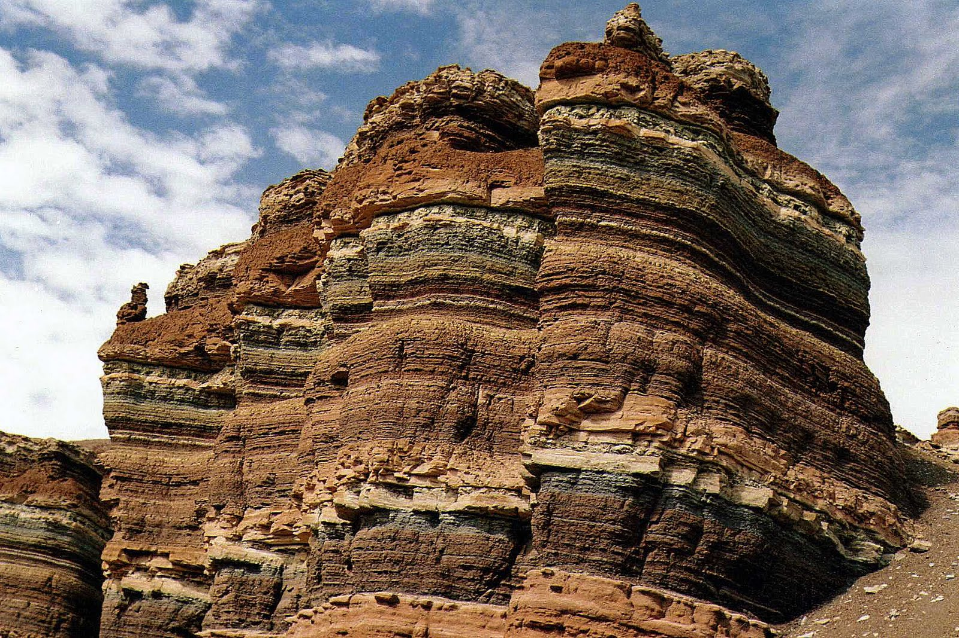
Compare to X-cube
Foliation
2D Toric Code
Smooth deformation
L_{x} × L_{y} × L_{z}
L_{x} × L_{y} × (L_{z}+1)
Shirley, Slagle, Wang, Chen, 18

Slide 29
Compare to X-cube
Foliation
2D Toric Code
Smooth deformation
L_{x} × L_{y} × L_{z}
L_{x} × L_{y} × (L_{z}+1)
Exact exponential scaling of ground state degeneracy
Finite order of planons
Short range (no tail) statistics
K(131) is not foliated
Shirley, Slagle, Wang, Chen, 18

Slide 30
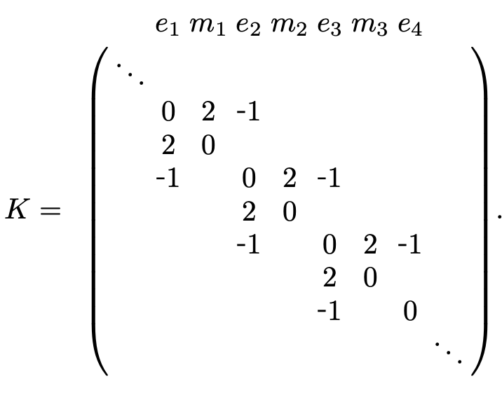
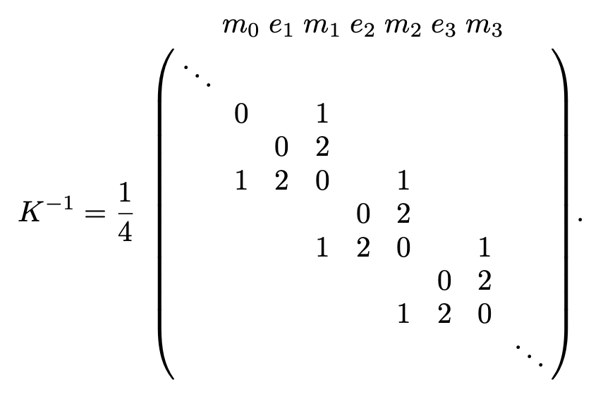
Foliated K matrix
Shirley, Slagle, Chen, 2020

Slide 31
Foliated K matrix
Shirley, Slagle, Chen, 2020

Slide 32
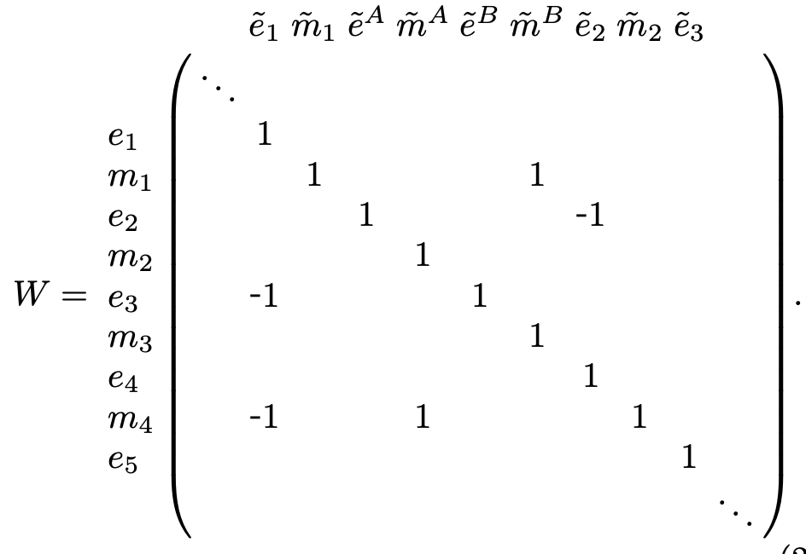
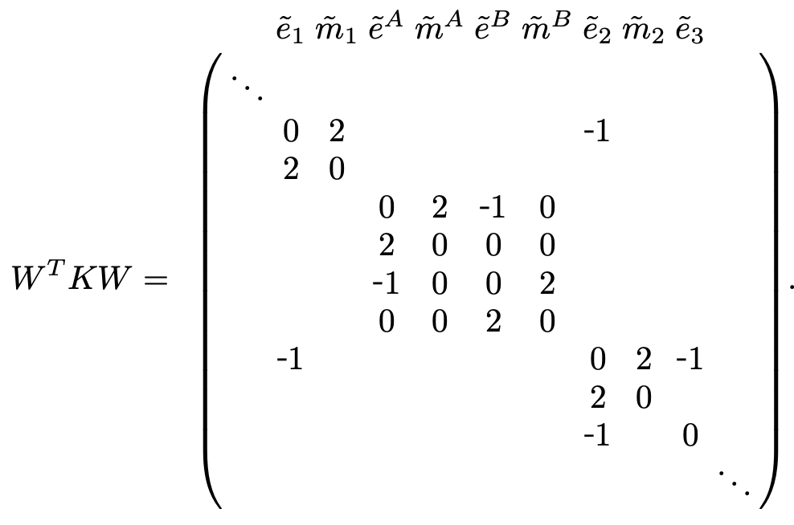
Foliated K matrix
Shirley, Slagle, Chen, 2020

Slide 33
Foliated K matrix
Z₂ x Z₂ gauge theory
Smooth deformation
L_{x} × L_{y} × (L_{z}+1)
L_{x} × L_{y} × L_{z}
Shirley, Slagle, Chen, 2020

Slide 34
Foliated K matrix
Z₂ x Z₂ gauge theory
Smooth deformation
L_{x} × L_{y} × (L_{z}+1)
L_{x} × L_{y} × L_{z}
Shirley, Slagle, Chen, 2020

Slide 35

$∞$-d K matrix and Fracton

Slide 36
$∞$-d K matrix and Fracton
Beyond exactly solvable models

Slide 37
$∞$-d K matrix and Fracton
Beyond exactly solvable models
For foliated models
  Identify examples
  Calculate properties
  Study equivalence up to foliation using K matrix formulation

Slide 38
$∞$-d K matrix and Fracton
Beyond exactly solvable models
For foliated models
  Identify examples
  Calculate properties
  Study equivalence up to foliation using K matrix formulation
For non-foliated models
  Identify examples
  Calculate properties
  How to interpret their structure?

Slide 39
But first
Question:
Do they represent local 3D model?
Are they gapped or gapless?
Form of fractional excitation

Slide 40
But first
Question:
Do they represent local 3D model?
Are they gapped or gapless?
Form of fractional excitation
Answer:
In terms of Laughlin wave function (Qiu, Joynt, MacDonald, 1990; Naud, Pryadko, Sondhi, 2000)

Slide 41
But first
Question:
Do they represent local 3D model?
Are they gapped or gapless?
Form of fractional excitation
Answer:
In terms of Laughlin wave function (Qiu, Joynt, MacDonald, 1990; Naud, Pryadko, Sondhi, 2000)
For quasi-diagonal K matrix
  Lattice realization
  String operator
  Spectrum (field theory calculation)

Slide 42
Lattice realization
IQH
1
Stack of IQH
Coupled to planar U(1) symmetries
Gauge the U(1) symmetries
2
3
4
5
6
7

Slide 43
Lattice realization
IQH
1
Stack of IQH
Coupled to planar U(1) symmetries
Gauge the U(1) symmetries
2
3
4
5
6
7

Slide 44
Lattice realization
IQH
1
Stack of IQH
Coupled to planar U(1) symmetries
Gauge the U(1) symmetries
2
3
4
5
6
7
Integrate out the fermions

Slide 45
Lattice realization
IQH
1
Stack of IQH
Coupled to planar U(1) symmetries
Gauge the U(1) symmetries
2
3
4
5
6
7
Integrate out the fermions
Fermion hopping
Gauge symmetry

Slide 46
String operator
fermions
Lattice gauge fields

Slide 47
String operator
fermions
Lattice gauge fields
In terms of CS gauge field
In terms of lattice DOF?

Slide 48
String operator
Charge vector (1,0,0,…)

Slide 49
String operator
Charge vector (1,0,0,…)
In terms of lattice DOF
creates gauge charge in one layer

Slide 50
String operator
Charge vector (1,0,0,…)
In terms of lattice DOF
creates gauge charge in one layer
creates gauge flux across the layers according to

Slide 51
String operator
Charge vector (1,0,0,…)
In terms of lattice DOF
creates gauge charge in one layer
creates gauge flux across the layers according to
adiabatically evolves the matter field

Slide 52
Spectrum
Gap is proportional to smallest |eigenvalues of K |^2

Slide 53
Spectrum
Gap is proportional to smallest |eigenvalues of K |^2
Gapped:
Gapless:

Slide 54
Spectrum
Gap is proportional to smallest |eigenvalues of K |^2
Gapped:
Gapless:
Instability?
Gapless spin liquid?
Gapless fracton?
upcoming work with Xiuqi Ma and Hotat Lam
see also Joseph Sullivan, Arpit Dua, Meng Cheng, arXiv: 2109.13267

Slide 55
Summary
Lattice construction for all quasi-local K matrices

Slide 56
Summary
Lattice construction for all quasi-local K matrices
Local models, fractional excitations

Slide 57
Summary
Lattice construction for all quasi-local K matrices
Local models, fractional excitations
Gapped / Gapless

Slide 58
Summary
Lattice construction for all quasi-local K matrices
Local models, fractional excitations
Gapped / Gapless
Examples of gapped foliated, gapped non-foliated, and gapless

Slide 59
Open questions
Conditions for gapped foliated / gapped non-foliated

Slide 60
Open questions
Conditions for gapped foliated / gapped non-foliated
Equivalence classes of foliated models (as equivalence class of K matrices)

Slide 61
Open questions
Conditions for gapped foliated / gapped non-foliated
Equivalence classes of foliated models (as equivalence class of K matrices)
General properties of gapped non-foliated models (degeneracy, fusion group, statistics, RG, etc.)

Slide 62
Open questions
Conditions for gapped foliated / gapped non-foliated
Equivalence classes of foliated models (as equivalence class of K matrices)
General properties of gapped non-foliated models (degeneracy, fusion group, statistics, RG, etc.)
What do gapless K matrices represent?

Slide 63
Open questions
Conditions for gapped foliated / gapped non-foliated
Equivalence classes of foliated models (as equivalence class of K matrices)
General properties of gapped non-foliated models (degeneracy, fusion group, statistics, RG, etc.)
What do gapless K matrices represent?
What about non-quasi-diagonal ones?

