Slide 1
Chern Simons Conference, Berkeley Nov. 18, 2021 The Universe from a Single Particle – metric crystallization
Modj Shokrian Zini, Mike Freedman

Slide 2
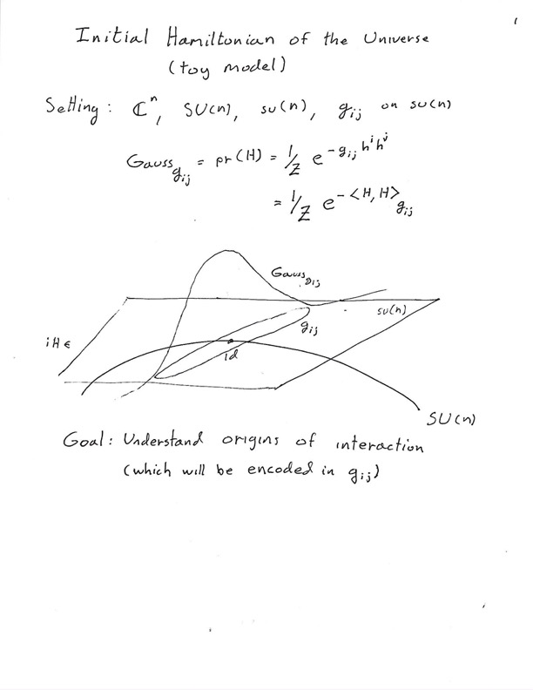

Slide 3
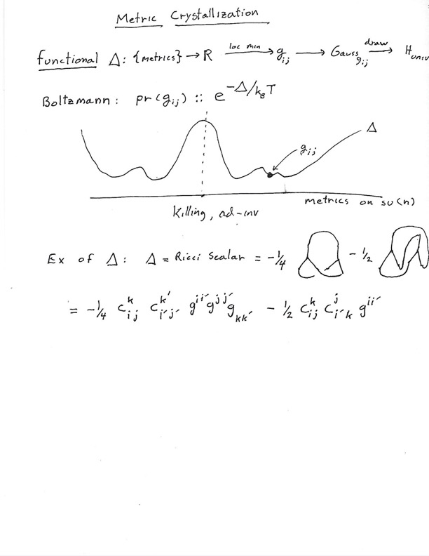

Slide 4
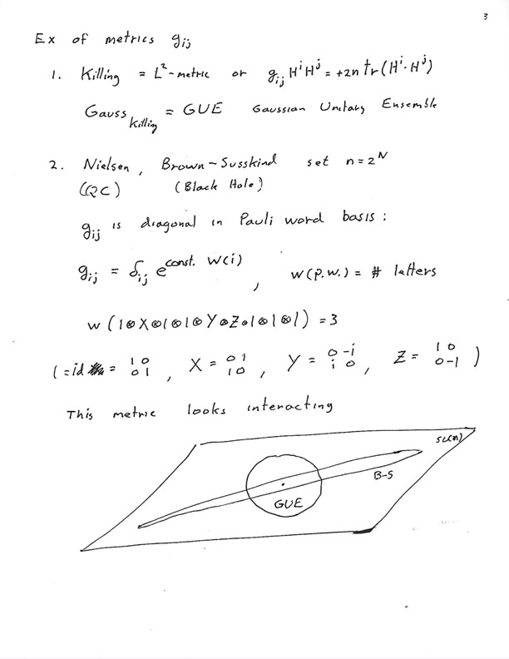

Slide 5
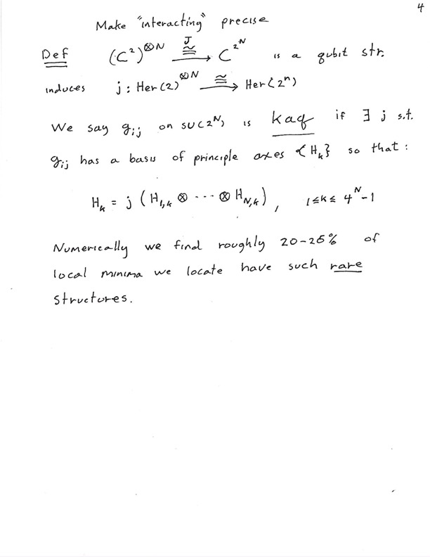

Slide 6
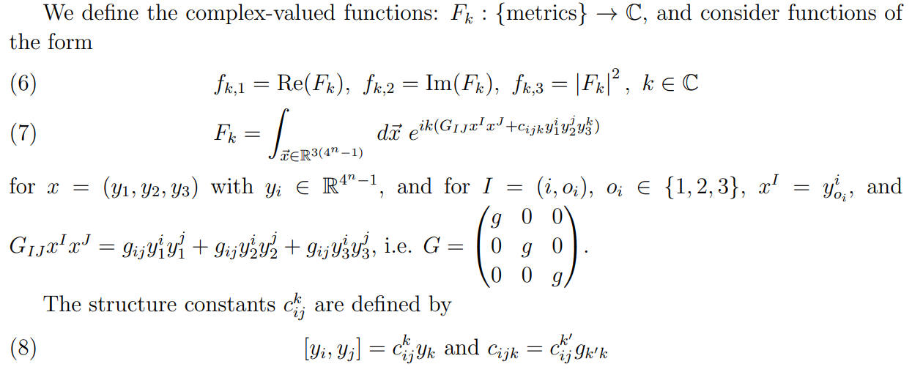

Slide 7
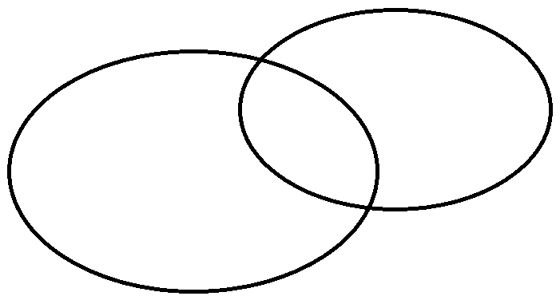
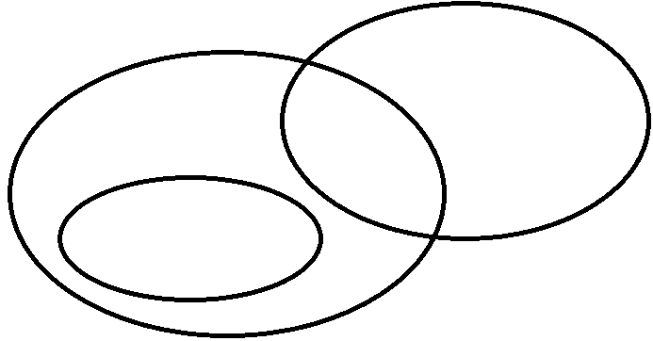
su(4) metrics
sub
sp(2):10,5 *
Scalar curvature functional
kaq
so(4): 6,9 penalty**
sub
sp(2): 10,5
“2-6” functional
kaq
3,1,1,8,2
3,1,1,4,4,2 ***
sub
kaq: 3,1,1,8,2 ***
1,1,2,4,2,1,2,2
sp(2): 10,5
“2-4” functional
4,6,4,1 ***
Majorana
* Same sp(2) in all cases
** terminology due to Brown & Susskind
***slightly delicate

Slide 8
su(8) metrics
sub
kaq
30,32,1
“2-6” functional
10,15,1,32,5
1,9,1,12,16,9,8,4,3
same
sub
kaq
30,32,1
“2-4” functional
1,1,15,1,2,4,16,16,2,1,2
It decomposes to $ℂ^{4}⊗ℂ^{2}$

Slide 9
Away from powers of 2
Computed minima $g$for functionals, for $su\left(5\right),su\left(6\right),su\left(7\right).$
Eigenbasis found with high degeneracy patterns; e.g. $su\left(6\right)$ : (10,3,1,16,5) or (3,4,9,12,3,3,1) or (5,8,8,1,3,10).
Many Kaq examples found for $su\left(6\right)$ decomposing to $ℂ^{2}⊗ℂ^{3}$ (9 out of 30 simulations).
Found examples of ‘almost’ kaq like $ℂ^{5}=ℂ^{2}⊗ℂ^{2}⊕ℂ^{1}$ or $ℂ^{7}=ℂ^{2}⊗ℂ^{3}⊕ℂ^{1}$ or $ℂ^{2}⊗ℂ^{2}⊕ℂ^{3}$. ‘almost’ kaq : there are upper left blocks of the form $ℂ^{2}⊗ℂ^{2}$ or $ℂ^{2}⊗ℂ^{3}$. Call This “Leaky Universe”. Might be hazardous .

Slide 10
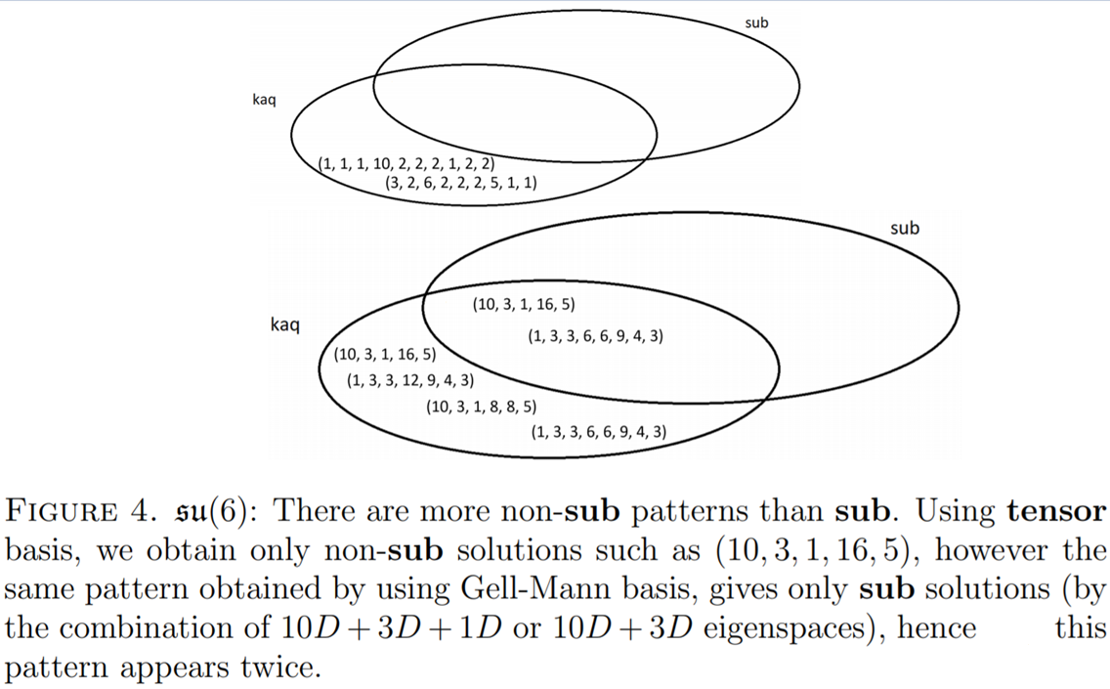

Slide 11
Venn diagrams below with 2-4 on the left and 2-6 on the right

Slide 12
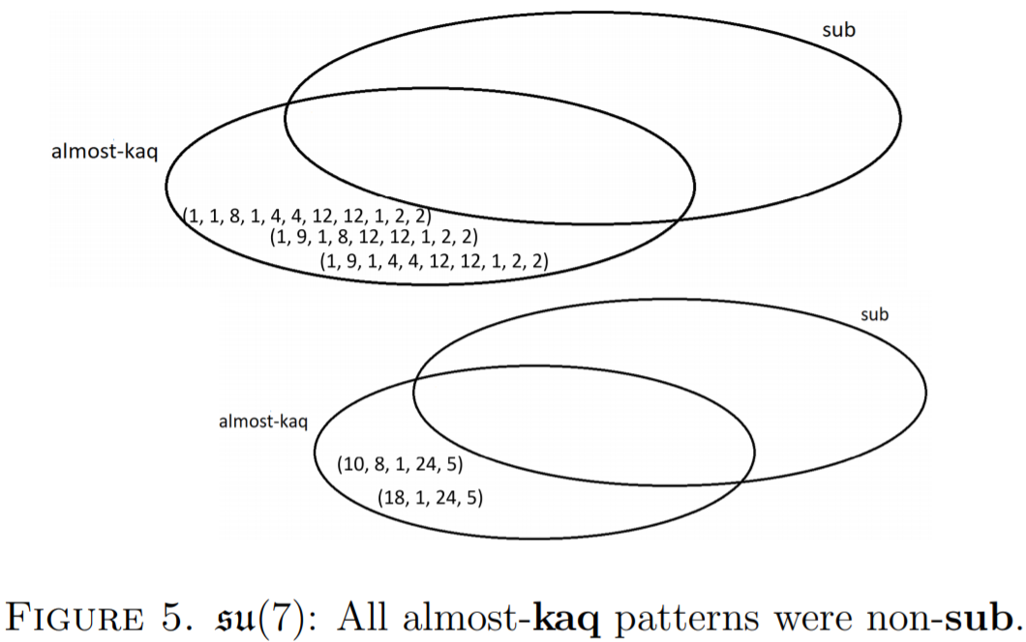

Slide 13
Kam-ness of $su\left(4\right)$ and $su(8)$
Kam: When each principle axis of the metric $g$ is a homogeneous polynomial in terms of Majorana operators.
$HomMa_{j}$: Homogeneous polynomials of degree $j$ of Majorana operators.
For $su(2^{n})$ we have $2n$ Majorana operators and:
$span(HomMa_{1},…,HomMa_{2n}$) = $su\left(2^{n}\right)$

Slide 14
Fermionic Brown-Susskind metric observed
We show the best fitting solution on $su\left(4\right)$ and $su\left(8\right)$in the next slide, giving mean loss and the value of $a$ for the best fit exponential $y=exp⁡(a x)$ in red.
Also shown in blue is the Majorana degree initialization $y=ω^{x}$.
Also displayed is an example of a minimum with no good fit.
The average of the mean loss for both best case and average case is much smaller for exp penalty schedule than for Gaussian schedule.

Slide 15
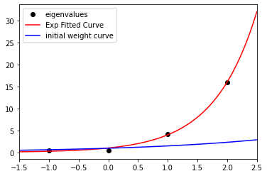
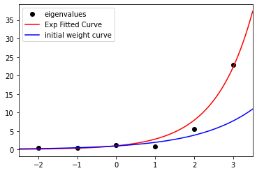
Examples of Good fits
$F_{24}$(k=200) for $su\left(4\right)$
omega is 1.563
pattern is [6, 4, 4, 1]
Eigs = [0.38662, 0.50202, 4.14034, 16.04194]
mean loss is 0.114; a = 1.388
$F_{26}$(k=500) for $su\left(8\right)$
omega is 1.9991
pattern is [6, 15, 15, 20, 6, 1]
Eigs = [0.45919, 0.50651, 0.87894, 1.18111, 5.61139, 22.88713]
mean loss is 1.599; a = 1.034

Slide 16
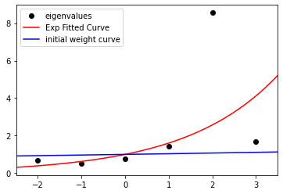
Solution has eigenvalues going up and down resulting in a bad fit
$F_{24}$(k=1000) for $su\left(8\right)$
omega is 1.035
pattern is [15, 6, 20, 15, 1, 6]
Eigs = [0.49187, 0.67116, 0.75188, 1.42818, 1.66636, 8.55983]
mean loss is 7.014; a = 0.472

Slide 17
Conclusions:
Nature abhors a naked Hilbert space and will try to dress it in a tensor or Majorana structure. For D=2^n, Majorana degree groupings with Brown-Susskind exponential penalty factors are seen.
For a random initial dimension, (not 2^n), we guess that all but log many dimensions develop a tensor or Majorana structure – while a few dimensions are left aside: The Leaky Universe Scenario
Next: Following a suggestion of Adam Brown, we plan investigate the pair (initial Hamiltonian, initial state), by adding a source term to F_24 and F_26. Then production of entropy over mesoscopic times can be studied.
Finally: We have seen locality emerge, but where does space come from? Will interactions form a complete graph or lattice, perhaps Leech? (As suggested by Greg Moore) – to check by brute force needs 10^12 qubit QC.

Slide 18
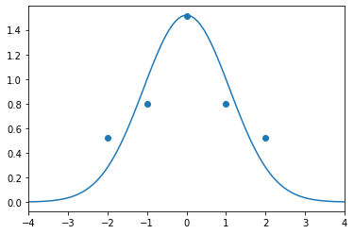
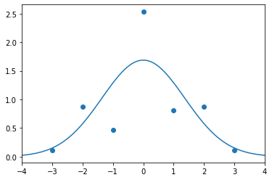
integral $F_{24}$(k = 100) for $su(4)$
integral $F_{24}$(k = 1000) for $su(8)$
pattern is [1, 15, 15, 12, 20]
Eigs = [0.10738, 0.46524, 0.80444, 0.87465, 2.53208]
pattern is [1, 8, 6]
Eigs = [0.52527, 0.79581, 1.50958]
Fit mean loss is 0.04; std = 1.09
Fit mean loss is 0.258; std = 1.3633

Slide 19
Exponential initialization according to degree
We show the best fitting solution on $su\left(4\right)$ and $su\left(8\right)$in the next slide, giving mean loss and the value of $a$ for the best fit exponential $y=exp⁡(a x)$ shown in red.
Also shown in blue is the Majorana degree initialization $y=ω^{x}$.
There are solutions that are far away from being fit, with such an example shown for $su(8)$.
Both smallest and average mean loss for the fit to exp was much lower than for the fit to the Gaussian, for both su(4) and su(8).

