Slide 1
A critical look at change: How can theory help scale and sustain equitable practices?
Daniel Reinholz (@Dr_DanR)
San Diego State University
Naneh Apkarian (@NanehApkarian)
Arizona State University

Slide 2
Roadmap
Introduction to Change Theory
Systematic Review
A Critical Look
Discussion

Slide 3
Introduction to Change Theory

Slide 4
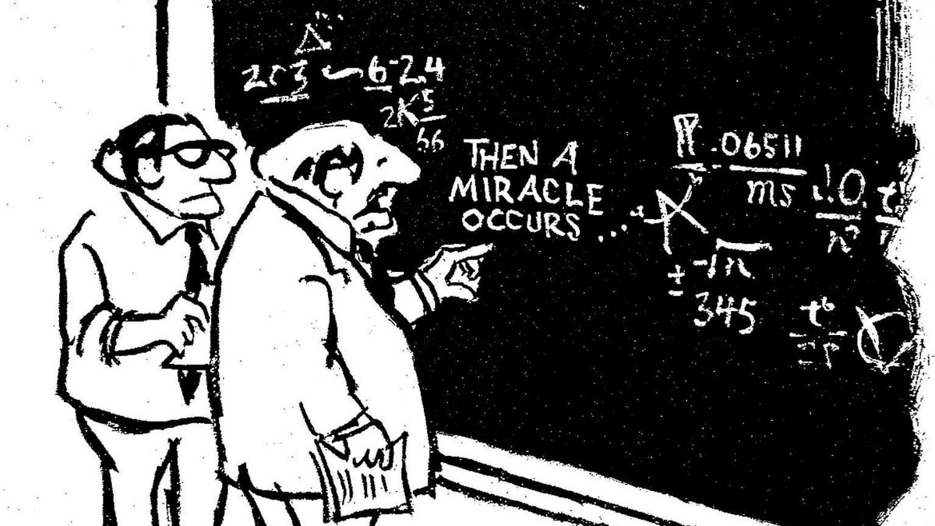
Notes:
As more and more of us try to foster change and study it, we have turned to change theory as a source of knowledge about what has already been learned about change
Appropriately, funding agencies are also calling on proposers to ground their work in change theory

Slide 5
Researchers and change agents increasingly draw on change theory
What have others learned about how to make change happen in STEM higher education?
Funding agencies now routinely ask proposers to draw on change theory
Notes:
As more and more of us try to foster change and study it, we have turned to change theory as a source of knowledge about what has already been learned about change
Appropriately, funding agencies are also calling on proposers to ground their work in change theory

Slide 6
But...identifying fruitful change theories is challenging
Math
Chemistry
Biology
Engineering
Scholars studying change in STEM are relatively siloed by discipline
Relevant theories come from diverse disciplines (in which we are not trained)
Notes:
After discussing highlighting points on slide…
And yet drawing on change theory is key to building our collective knowledge about how to make change happen in STEM higher ed. Using, refining, building theory is how we encompass what we know about change. Most projects are essentially N = 1, so we need many investigations to identify larger patterns of how change occurs
Comparisons are facilitated if researchers draw on similar change theories
we see a need for the same theories to be used across contexts, and the results shared in a way that research projects can be synthesized together

Slide 7
Yet change theory is crucial
Change theory can help us:
Contribute to and draw on what is known about enacting change
Generalize across projects that are essentially N = 1
Explain how our own work relates to that conducted by others
Notes:
And yet drawing on change theory is key to building our collective knowledge about how to make change happen in STEM higher ed. Using, refining, building theory is how we encompass what we know about change. Most projects are essentially N = 1, so we need many investigations to identify larger patterns of how change occurs
Comparisons are facilitated if researchers draw on similar change theories

Slide 8
Change theory is….
Theory of change is...
a framework of ideas, supported by evidence, that explains some aspect of how or why systemic change in STEM higher education occurs
generalizable beyond a single project
disseminated through scholarly channels and thereby contribute to collective knowledge
an approach to design and evaluation that makes explicit how a particular project is actually supposed to make change happen, and underlying assumptions
tailored to a single change initiative
created and used primarily (or exclusively) by the project team
Notes:
At this point we need to distinguish between two related, but distinct concepts.
Change theory is…
Theory of change iss
Related concepts to a theory of change include logic model, outcome maps, theory of action, theory of cause, logical frameworks

Slide 9
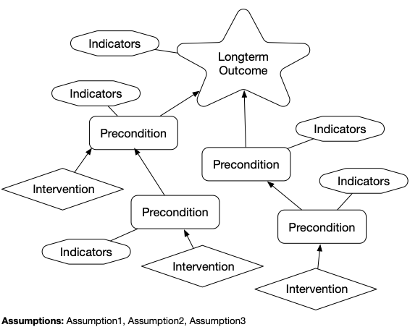
We examined how researchers have used change theory to inform four components of a theory of change
Four components of a theory of change:
Rationale and assumptions - how does change actually happen and what implicit ideas might we be relying on
Context - identifying, describing, and relating parts of a system
Indicators - metrics of progress toward short-term goals (preconditions) and longterm outcomes
Interventions - the concrete steps taken to achieve the desired outcomes
Sample theory of change diagram
(adapted from Reinholz & Andrews 2020)
Context for change
Rationale
Rationale
Notes:
A theory of change maps out the long-term goal, the intermediate steps on the path toward the goal (called preconditions), the interventions needed to achieve the preconditions, indicators that will be used to know when preconditions are met, the context in which change takes place, and assumptions that are part of the theory of change.
We focused on four fundamental components of a theory of change in this review.
Rationales are the glue that holds a theory of change together. These explain how an intervention will lead to change and why an indicator will allow you to measure if preconditions have been met.
Underlying assumptions are closely related. Give example of appreciative inquiry or using data to convince faculty to change.

Slide 10
Systematic Review

Slide 11
Approaches to identifying articles
N = 191 articles published 1995-2008
Journal scouring for 15 journals, 2008 - 2019
N = 8 articles
N = 198 articles published 2008-2019
N = 12 articles from reverse citation search
Notes:
Use pictures to show the 4 ways

Slide 12
Inclusion and exclusion of articles
K12, pre-service teachers, faculty work beyond teaching
Not STEM-specific
No use of change theory
Initial corpus of papers:
409
Papers for systematic review:
97
Screening for inclusion
Notes:
Idea for a visual

Slide 13
Analyzing articles and synthesizing results
Each article: Analyze for how change theory informed the work’s
Rationale and assumptions about how change occurs?
Conceptualizations of the context of change?
Indicators of change?
Interventions to achieve change?
Each change theory: Group articles by change theory, write summary for each manuscript in the group → generate detailed summaries for change theory
Across change theories: Synthesize across theories to identify emergent themes

Slide 14
Results

Slide 15
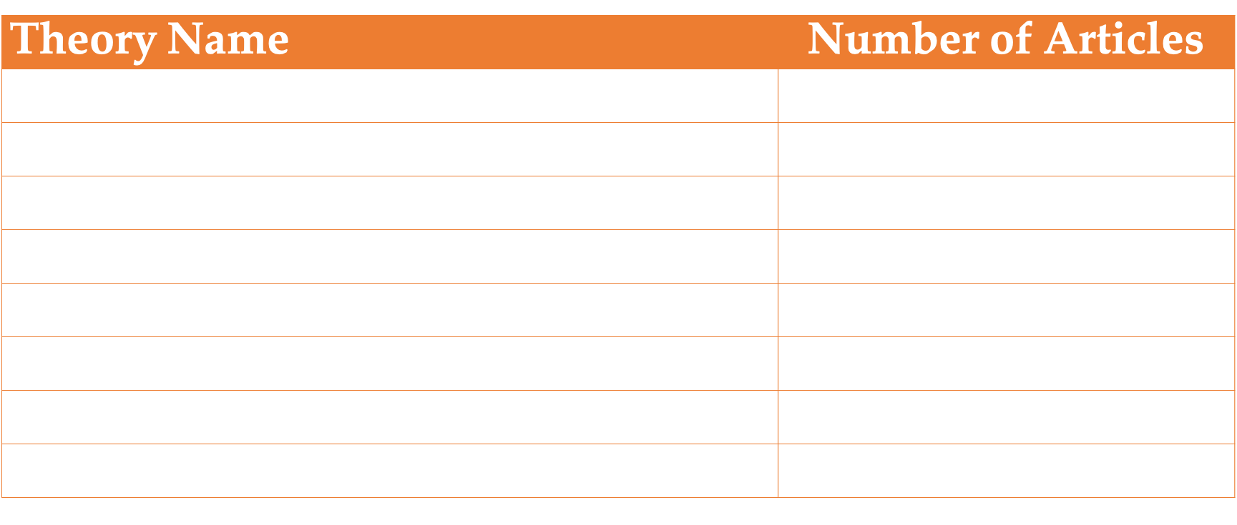
Most commonly-used change theories

Slide 16
Change theories used by 1 or 2* articles
4Is*
Austin’s Model
Biglan’s Model
Boundary Spanning
CHAT
CACAO Model of Change
Cognitive apprenticeship
Collaborative action-based research
Complexity leadership
Double-Loop Learning
Improvement Science
Institutional agents
Institutionalization
Intersectionality
Kotter’s 8 Stages*
Macrosystems
Moses organizational theory
Social movement mobilization
Social network theory
Transformational leadership*
Weick’s sensemaking
Also, 11 articles developed their own change theory.
Notes:
Don’t dwell here. We show this slide to emphasize that many change theories were used by a single paper or maybe two.

Slide 17
How was theory used: Diffusion of Innovations as an example
Rationale and assumptions: Most often used stages of change to analyze faculty adoption of evidence-based teaching, including prior conditions. Some examined communication channels.
Context: Did not inform conceptualizations of the context of change
Indicators: Focused on faculty teaching practices, including awareness of practices, and the adoption experiences of faculty
Interventions: Did not generally inform interventions. Exceptions include interventions informed by the general idea that interactions between colleagues can spread ideas
Notes:
DoI describes how new innovations become more widely used. Posits that innovations spread among adopters over time through particular communication channels that exist within a social system. This theory stipulates distinct stages of the change process, characteristics of an innovation that influence adoption, different categories of adopters, and different communication channels. It also distinguishes between types of knowledge someone need to use an innovation effectively, and to adapt an innovation to their context.
Most commonly, projects used the stages of of innovation adoption to analyze faculty adoption of evidence-based instructional practices

Slide 18
Theme 1: Research focuses mostly on individual change
Theory focused on individual change = change efforts focused on changing individuals rather than systems
But other theories highlight the role of the system and could be productive for improving STEM education
Notes:
Now some of these theories (in yellow boxes) could be used to think about the context of change, but that is almost never how they were used.

Slide 19
Theme 2: Research often draws on theory in a superficial way
Rather than briefly reviewing a change theory in the introduction of a paper or loosely the spirit of a change theory,
Context for change
Rationale
we need to use change theory as a lens or guide that directly informs specific components of the work, including interventions, focus, research questions, measurement and evaluation, data analysis, and data interpretation.
Rationale
Notes:
We are excited that the field has reached a level of maturity where work can meaningfully draw on theory. We think this is crucial to generating generalizable knowledge about change. Theory has the potential to encompass our best current understanding of how to achieve and sustain change ,
A key point here is that it is important how change theory is used. Unless a number of projects draw substantially on the same theoretical principles, reports on their findings will be difficult to compare and learn from collectively.
drawing on theory is how we generate and build upon knowledge as a field. Otherwise, work may be published but will do little to meaningfully progress our understanding or our ability to actually enact and sustain critical changes in STEM higher education.

Slide 20
Theme 3: Most research is theoretically disjointed
40 change theories used in 97 papers = striking lack of theoretical coherence
More commonly-used theories were tailored and built upon, which builds our collective knowledge of how change does (and does not) occur
Adoption-innovation continuum (Henderson & Dancy 2008)
Propagation paradigm (Froyd et al. 2017)
Diffusion of Innovations
Cycles of change and significant adaptation are common (Andrews & Lemons 2015; Freud et al. 2017; Henderson & Dancy 2008; Marbach-Ad & Rietschel, 2016))
Notes:
Only two theories used in more than six articles
Not proposing there is a perfect theory or that any theory could be relevant across all contexts. Contexts are unique and educational systems are complex. Most projects need more than one change theory. BUT this extreme lack of coherence is a barrier to generalization.

Slide 21
Read the full paper in International Journal of STEM Education

Slide 22
A critical look

Slide 23
Challenges Identified Through this Synthesis
Lack of formal opportunities for people to learn about change
Very little research reviewed focused on diversity, equity, and inclusion
Research was theoretically disjoint (many theories, not reused)

Slide 24
Recommendations from (this & other) Syntheses
Remove barriers and create drivers for change (e.g., incentives)
Communication is critical between change agents and stakeholders at all levels
Afford individuals agency to participate, take ownership, and accommodate their own individual goals
For sustainability: you need to establish a culture that will perpetuate what you want to see and inhibit what you don’t
Systems are complicated! Use multiple theories, tactics, etc. to address them all.
Notes:
These generally apply to PLANNED changes (not the stuff that just… happens when no one is paying attention)

Slide 25
Critical Questions
Aimed at scholarship about change:
How do we enhance collaboration between experts in change and DEI?
How do we create more generalizable knowledge about how change happens?
Aimed at change agents:
How do we build on lessons learned elsewhere to implement real change?
What theories (that go beyond individual change) can we leverage to increase our chances of success?
Aimed at attendees here:
How can integrate theories of change with the lessons of this workshop to maximize our collective impact – making change and centering equity?
Notes:
These shouldn’t be viewed as disjoint groups of people, just different emphases

Slide 26
Discussion

Slide 27
Questions, Comments, Ideas
Daniel Reinholz (@DR_DanR), daniel.reinholz@sdsu.edu
Naneh Apkarian (@NanehApkarian), Naneh.Apkarian@asu.edu
Join ASCN Working Group 1 for further discussions about change theory

