Slide 1
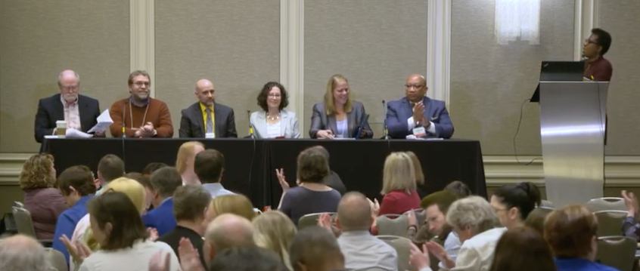
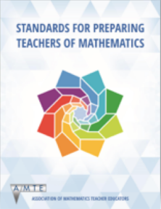
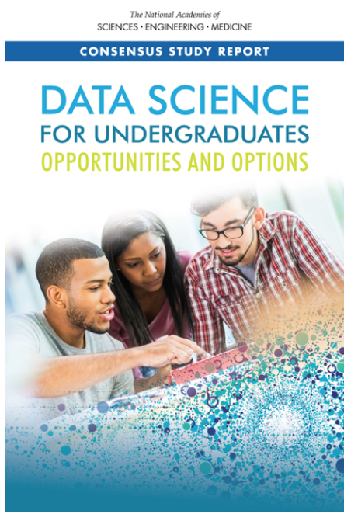
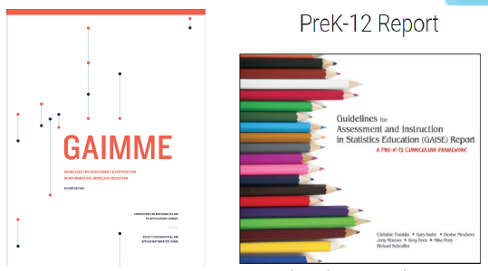
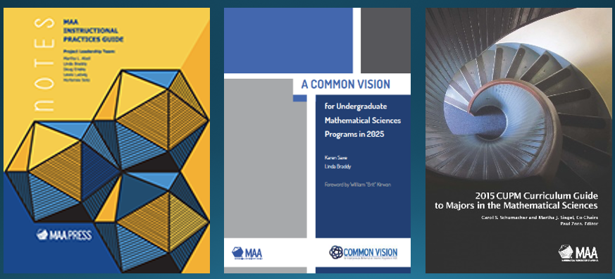
High School to College Mathematics Pathways
May 5–7, 2019

Slide 2
High School to College Mathematics Pathways:
Supporting State Efforts for
Mathematics Alignment
October 5, 6, & 13, 2020
State Issues (21 states):
Math Pathways Definition and Alignment (19)
Communications (13)
Teacher Recruitment and Support (12)
Standards, Course Creation (12)
College Readiness and Placement (10)
Institutionalizing Math Alignment (9)
Advising (9)
Policy Issues (9)
Equity Priorities (8)
Program Evaluation (7)

Slide 3
High School to College Mathematics Pathways
Struggles, Surprises, Setbacks, and Successes:
Lessons learned to help us move forward
May 1–3, 2022, Hyatt Regency, Reston, VA
Lessons from the scan of all 50 states
Opportunities for cross-state collaboration
Plenaries on
Data Science
Communications and Public Relations
Workforce Issues
There is no charge to attend, but a limited number of spaces left for this gathering. Anyone interested in attending should contact me at Bressoud@macalester.edu

