Slide 1
Why content knowledge matters in teaching: Implications for teacher education
Denise A. Spangler
University of Georgia

Slide 2
Mathematical Knowledge for Teaching
Knowing mathematics to pass a test ≠ knowing mathematics in the ways needed to teach it.
Teaching mathematics involves knowing
Representations
Analogies
Illustrations
Examples
Explanations
Demonstrations
Shulman, 1986

Slide 3
And also
Knowing
What makes a topic easy or hard
Students’ preconceptions and misconceptions
Strategies to address misconceptions
Shulman, 1986

Slide 4
A recent study
Conducted by Jisun Kim, University of Georgia
5 geometry/measurement tasks, given one at a time over a semester
Preservice teachers had to
Solve the task
Examine student solutions to determine if they were correct
Identify causes of errors
Propose instructional strategies to address the causes of the errors

Slide 5
Findings of the study
Preservice teachers
generally got the correct answer themselves, but in some cases they exhibited the same misconceptions as the students even though the topic had been addressed in a course.
focused on the answer, not the solution path.
did not attend to intuitive or visual thinking.
attributed errors mostly to faulty procedural knowledge.

Slide 6
Findings, Cont’d.
Diagnoses did not match prescriptions.
Small, weak repertoire of instructional strategies; often wanted to “tell” students the correct answer.
Used examples from class for instructional strategies.

Slide 7
Tasks
Rectangle I has a larger perimeter than Rectangle II. Can you conclude that Rectangle I also has a larger area than Rectangle II? Why or Why not?
Compare areas of 2 triangles where one is obtuse
Possible triangles (more than one obtuse angle, 3 acute angles)
Determine if two triangles are similar
Quadruple the volume of a rectangular solid

Slide 8
Student response 1

Slide 9
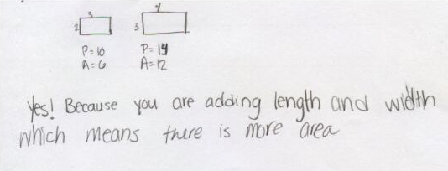
Student response 2

Slide 10
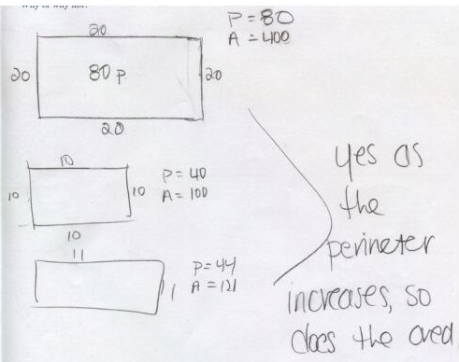
Student response 3

Slide 11
Student response 4

Slide 12
Implication for teacher education
Focus on planning but shift
Away from lesson planning
Toward task planning
Task dialogues (Crespo, Oslund, & Parks, 2011)

Slide 13
Task Dialogues
Task–we solve it in class
I give them possible student solutions
1 correct
2-3 incorrect or incomplete
What mathematical thinking could be behind that response?
What question could I ask next to test whether or not that is what the child was thinking? How would the child respond if it was or was not what she was thinking?
What is my next move?

Slide 14
Field Experience
They do the task dialogue task with children
They also do 3-5 other tasks that day, and in their plans THEY have to posit student responses

Slide 15
Example Task
In a soccer championship there are 6 teams. If all teams are going to play each other, how many games will there be in the championship?

Slide 16
Response 1
There will be 3 games because
Team A will play Team B
Team C will play Team D
Team E will play Team F.

Slide 17
Response 2
There will be 30 games because each team plays 5 other teams. There are 6 teams so
5 + 5 + 5 + 5 + 5 + 5 = 30.

Slide 18
Response 3
There will be 15 games:
AB BC CD DE EF
AC BD CE DF
AD BE CF
AE BF
AF

Slide 19
Observations
PST with lower content knowledge tend to
Have difficulty seeing children’s mathematical thinking, especially when it’s different from their own
Assume they know what children are thinking and do not ask
Push children to do it their way
Ask bite-sized questions, leading/directive questions
Start over rather than building from existing ideas
Don’t push on correct answers
Don’t make an effort to connect solution strategies

Slide 20
Observations, cont’d.
PST with higher content knowledge tend to
Ask more open questions
Try to get students to figure things out for themselves
Push students to analyze their solutions and go on from there rather than starting over
Pay attention to process as much as final answer
Link solution strategies
Extend correct solutions to push for generalizations

Slide 21
Conclusion
Focusing on preservice or inservice teachers’ content knowledge is necessary but not sufficient.
Need to develop OUR repertoire of tasks/activities to tap into the application of that content knowledge

