Slide 1
Pre-service mathematics programs for early and middle childhood teachers
Ohio State University

Slide 2
Ohio State Program

Slide 3
Here are a few of the ingredients to what we view as a successful program for the ECE group:
1) 50-student class size (this has become quite manageable for discussions and those who don't present in the whole class discussion are still required to be actively engaging with the problems because of the small group work)
2) small group work in every class (students are always thinking about the problems before any "lecture" and must practice articulating their ideas with each other)
3) the quality of the activities on which we base our discussions (this is due to choice of Beckmann as a text but also to collection of other outside activities all with the both appropriate intellectual challenge AND relationship to children's thinking or a viable K-3 classroom activity)

Slide 4
Here are a few of the ingredients to what we view as a successful program:
4) excellent TAs (hand-picked by the TA coordinator, but now also self-nominated after hearing about the work we are doing)
5) ties to education and experiences in schools (this helps with motivation of the course; several students have told us that this is the only course they have taken that relates directly to what they will teach, others have commented that they have been learning about how children think from our math classes)
6) communication with other departments, e.g., Special Ed (this has smoothed our path from the beginning when we first changed the requirements of the Math 105 students;

Slide 5
Here are a few of the ingredients to what I view as a successful program:
7) the 3-course sequence for early childhood majors seems to be helpful. It helps develop a cohort; we now also thoroughly understand and can articulate our program goals as they develop across the courses; students can see/feel their own growth over the 3 quarters. This has also allowed us to gradually move students from looking for formulas to apply to focusing on reasoning and explanation.
8) Finally, the head of T&L in the Education College has commented publicly that the students no longer dread teaching math! (We'll have to get that one in writing!)

Slide 6
Middle Childhood
For the MCE-math majors, many of the same features are at work! We are just less experienced at articulating those goals and have not had much feedback yet!

Slide 7
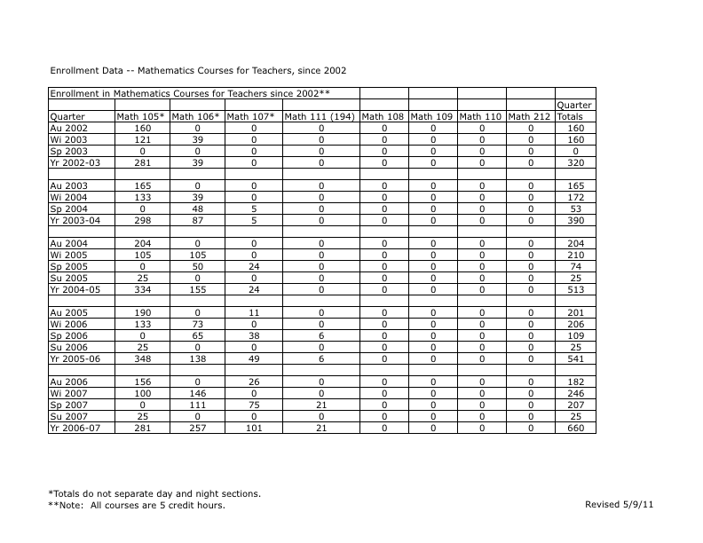

Slide 8
