Slide 1
Modeling Students’ Mathematics
Anderson Norton
Virginia Tech

Slide 2
Starter Problem
What does three-fifths mean?

Slide 3
Common Core Standards
3.NF.1. Understand a fraction 1/b as the quantity formed by 1 part when a whole is partitioned into b equal parts; understand a fraction a/b as the quantity formed by a parts of size 1/b.
4.NF.4. Understand a fraction a/b as a multiple of 1/b. For example, use a visual fraction model to represent 5/4 as the product 5 × (1/4), recording the conclusion by the equation 5/4 = 5 × (1/4).

Slide 4
Purpose
“If, as teachers, we want to foster understanding, we will have a better chance of success once we have more reliable models of students’ conceptual structures, because it is precisely those structures upon which we hope to have some effect.”
  von Glasersfeld & Steffe, 1991, p. 102

Slide 5
Understanding: The Role of Mental Operations
The candy bar shown below is five times as big as your candy bar, draw your candy bar.
What mental actions did you perform to solve the task?

Slide 6
Students’ Available Mental Operations
 | Grade 6 (N = 66) |  | Grade 7 (N = 56) |  | Grade 8 (N = 58)
Scheme/Operation | M | SD | M | SD | M | SD
Iterating | .86 | .35
Partitioning | .87 | .33
Partitive Unit Fraction Scheme | .61 | .49 | .61 | .49
Splitting | .44 | .50 | .55 | .50 | .66 | .48
Partitive Fraction Scheme | .17 | .38 | .25 | .44
Reversible Partitive Fraction Scheme |  |  | .13 | .33 | .19 | .40
Iterative Fraction Scheme |  |  |  |  | .12 | .33
Units Coordination |  |  |  |  | .26 | .44

Slide 7
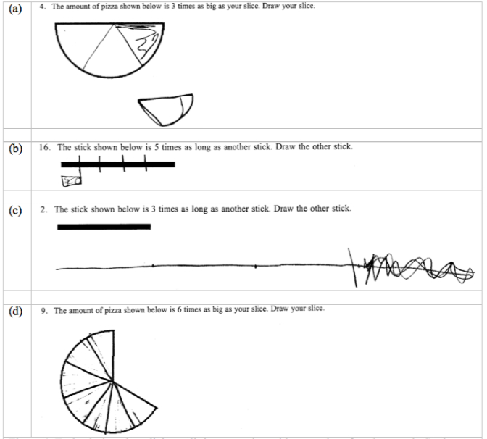
Splitting Tasks

Slide 8
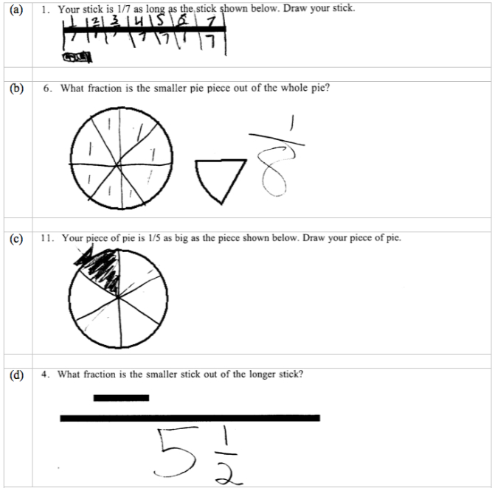
PUFS/EPS Tasks

Slide 9
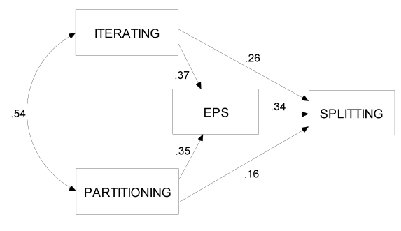
The Splitting Loope
Wilkins & Norton, JRME, 2011
Notes:
Introduce the three operations and EPS
Partitioning, as an operation, already has an inverse, in uniting
In topology, “continuity and separation” Piaget, (1950) Structuralism p. 26.
The inverse of iterating was previously disembedding.
Path analysis (r=.54 is a correlation; the rest are Beta, path coefficients)
Wilkins & Norton, in press

Slide 10
The Partitive Unit Fraction Scheme
What fraction is the smaller stick out of the larger stick?
Imagine what mental operations would be involved in generalizing this reasoning to non-unit proper fractions--the Partitive Fraction Scheme.

Slide 11

Isaac, 6th grade, April 26
Andy: What is bigger, a fourth or an eighth?
Isaac: an eighth
Andy: Show me.
Isaac: [draws circle with eight equal parts]
Andy: If this was a pizza and you could have one fourth of the pizza, how many slices would you get?
Isaac: Four
Andy: What does it mean to be a fourth?
Isaac: [long pause, as if confused]
Andy: Does one fourth mean one out of four?
Isaac: Sometimes.
Andy: What else might one fourth mean?
Isaac: Maybe a half.

Slide 12
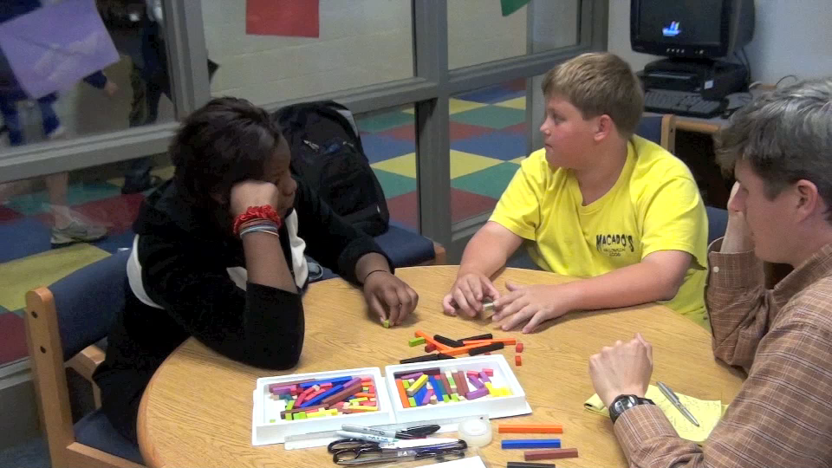
Isaac & Kadyeisha, May 4
Notes:
Cue 8:30. Until 13:20

Slide 13
Textbooks
“Throughout [the curricular development of fractions], which may take place over a few grade levels, the meaning of fractions seems to stay constant—part of a whole. As Thompson and Saldanha (2003) note, rarely do we see in the U.S. textbooks a treatment of non-unit fractions as a collection of unit fractions.”
  Watanabe, 2007, pp. 55-56
“In every county, mathematics textbooks exert a considerable influence on the teaching and learning of mathematics.”
  Howson, 1995, pp. 5-6

Slide 14
Reversing the Partitive Fraction Scheme
If the piece shown below is 3/5 of a candy bar, what does the whole look like?
What might Isaac say?
Notes:
Cue 20:20. Until 23:30

Slide 15
Isaac, May 12
Andy: If this [green stick] is three-fifths of a whole candy bar, what does the whole candy bar look like?
Isaac: [adds on four more bars]
Andy: If this [green stick] is three-fifths, what does one-fifth look like?
Isaac: [picks a red stick, one third the size of the green stick]
Andy: …what does the whole look like?
Isaac: [appends red stick to green stick] That. Two.
Andy: [repeats question, upon request]
Isaac: [puts five reds together] …four more on.

Slide 16
The Iterative Fraction Scheme
“Fractions as numbers in their own right”
    Hackenberg, 2007
Again, what mental operations would be necessary to solve the previous task when generalized to improper fractions.

Slide 17
Three levels of units coordinating
24 as a unit of six units of 4 units.
Seven-fifths as a unit of seven units of one-fifth, five of which produce the whole unit.

Slide 18
Constructing the Iterative Fraction Scheme

Slide 19
Isaac and Kadyeisha, May 17
Andy: Imagine in your heads how much you would get if I said you could have three-fifths of that candy bar.
Isaac: [uses fingers to span about one-third of the candy bar]
Andy: Ok. And when you get three-fifths of it, what does that mean?
Isaac: Oh! Wait! I thought you meant like… I thought you said one fifth!
Isaac: [later] I mean, I thought you said one third.

Slide 20
Understanding Fractions
Andy: Think to yourselves for a second. If somebody asked you, ‘what does three fifths mean?’ and you had to explain it to them, just in words, think about what you would say to them.
Kadyeisha: Three out of five
Isaac: Yeah. Three out of five. Bigger than a half.

Slide 21
A Cognitive Core for Common Standards
Common Core Standards place a much-needed emphasis on iterating unit fractions.
In order for students to meet these standards, teachers need to understand the cognitive core with which students operate, and deliberately support students’ constructions of new ways of operating
Teachers, as model builders, must address the gap between cognitive core and common core.

Slide 22
Professional Development
Cognitively Guided Instruction (CGI), Iterative Model Building (IMB), Studying Teachers’ Evolving Perspectives (STEP), and Fractions Recovery projects
Prediction Assessments
  see Norton, McCloskey, & Hudson, JMTE, 2011

