Slide 1
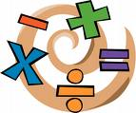
In the Era of the Common Core Standards
Teaching for Learning
David Foster
Silicon Valley Mathematics Initiative
www.svmimac.org

Slide 2
Optimism
"Optimism is an essential ingredient for innovation. How else can the individual welcome change over security, adventure over staying in safe places? A significant innovation has effects that reach much further than can be imagined at the time, and creates its own uses. It will not be held back by those who lack the imagination to exploit its use, but will be swept along by the creative members of our society for the good of all. Innovation cannot be mandated any more than a baseball coach can demand that the next batter hit a home run. He can, however, assemble a good team, encourage his players, and play the odds."
Robert N. Noyce

Slide 3
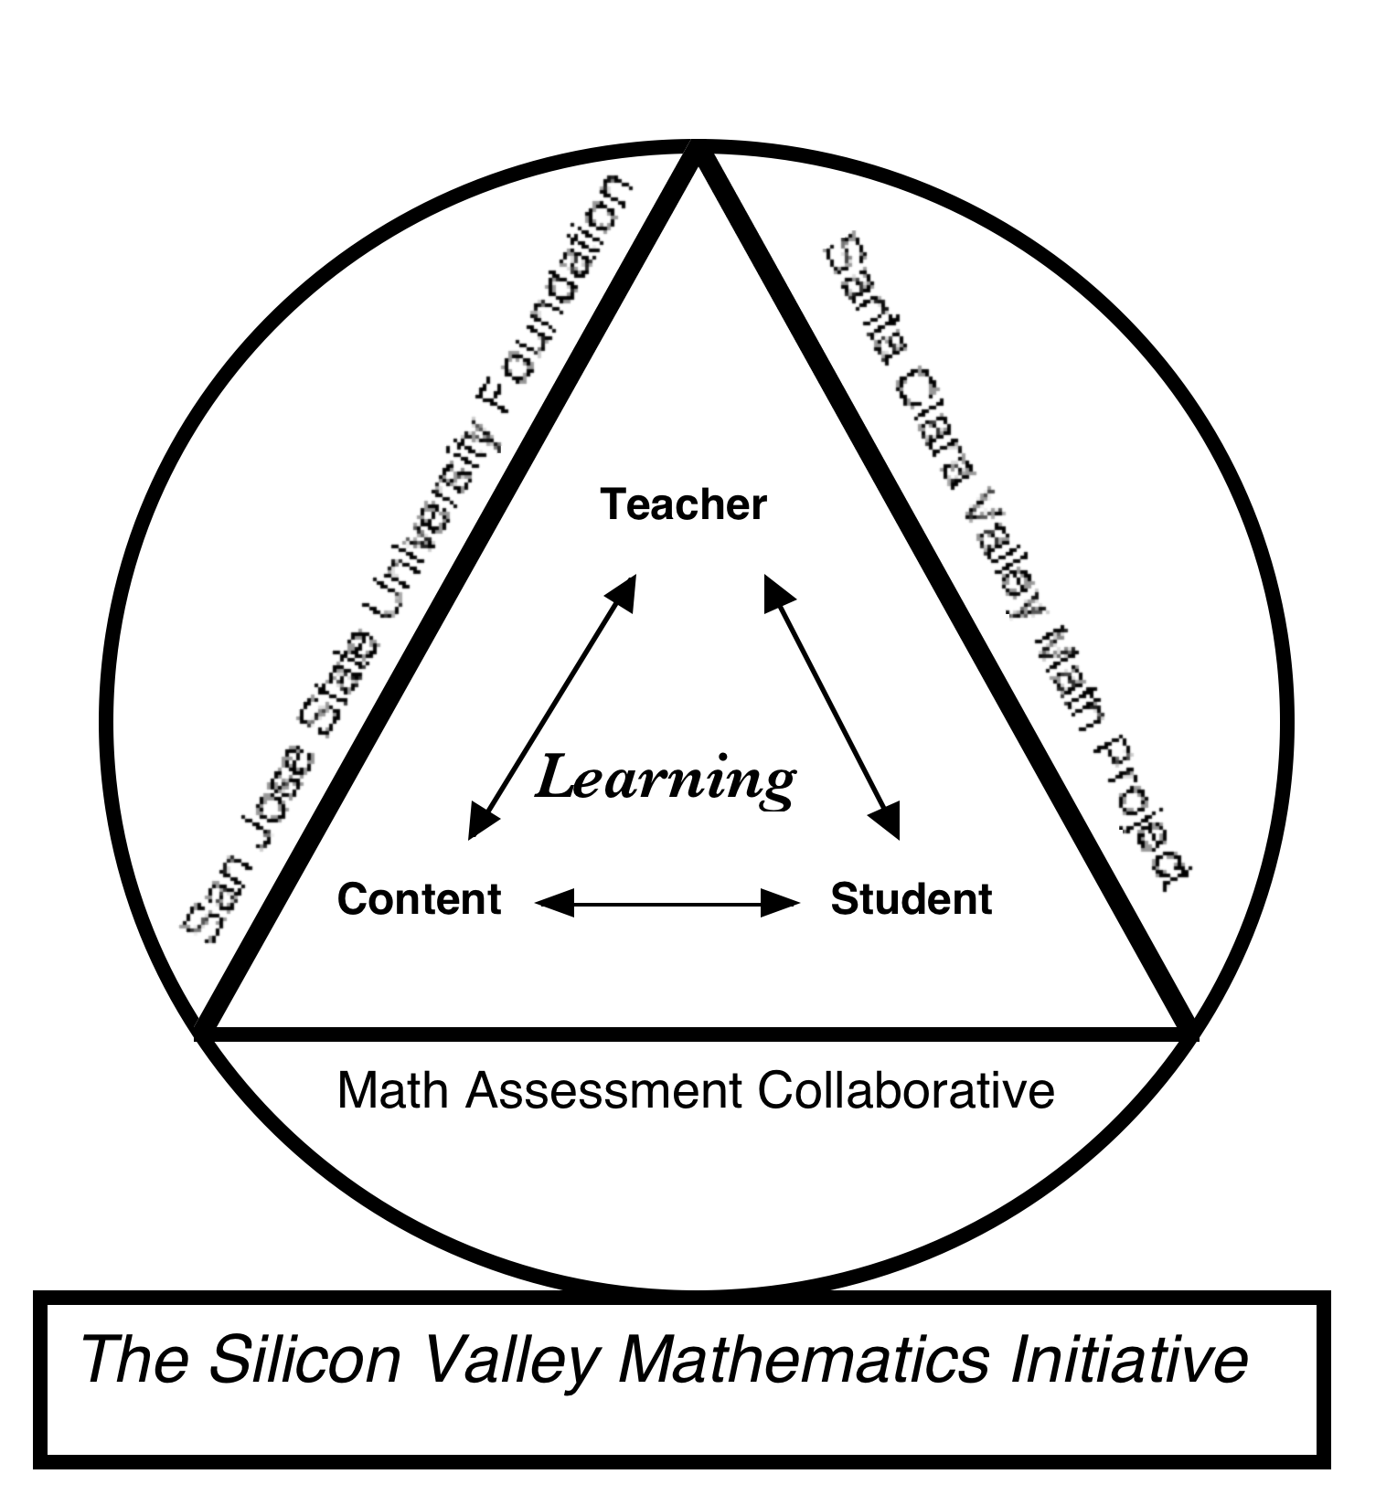
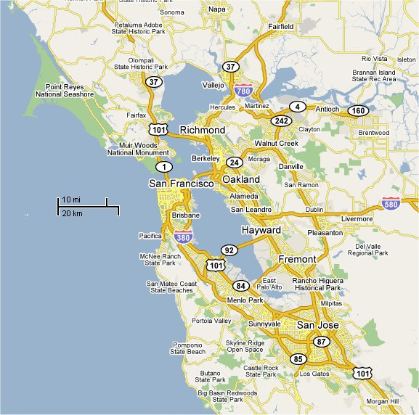
Silicon Valley Mathematics Initiative 41 Members School Districts and Charter School Networks
Antioch Unified
Aspire Charter Schools
Atlanta PS
Bayshore
Belmont
Berryessa
Bolinas - Lagunitas
Brisbane
Cambrian
Cristo Rey School Network
Cupertino
Discovery Charter School
Emery
Franklin - McKinley
Hamilton County, Tn
Hayward
Jefferson
Los Altos
Los Gatos
Menlo Park
Moreland
Portola Valley
Ravenswood
Salinas City Schools
San Carlos
San Ramon Valley
Santa Clara
Santa Cruz City
Saratoga
SMCOE County Court Schools
South San Francisco
Walnut Creek
Morgan Hill Charter School
Mt Pleasant
National Council of La Raza
New York City
Oakland Military Institute
Oakland Unified
Pacifica
Pajaro Valley
Palo Alto
Supporting Teaching and Learning of Mathematics Since 1996

Slide 4
Mathematical Practice
Make sense of problems and persevere in solving them.
Reason abstractly and quantitatively.
Construct viable arguments and critique the reasoning of others.
Model with mathematics.
Use appropriate tools strategically.
Attend to precision.
Look for and make use of structure.
Look for and express regularity in repeated reasoning.

Slide 5
Welcome to the Inside Mathematics Website
Welcome to Inside Mathematics, a professional resource for educators passionate about improving students' mathematics learning and performance.
This site features classroom examples of innovative teaching methods and insights into student learning, tools for mathematics instruction that teachers can use immediately, and video tours of the ideas and materials on the site.
Several allied initiatives dedicated to improving math teaching have contributed to this resource.
http://www.insidemathematics.org

Slide 6
Formative Assessment

Slide 7
Students and teachers Using evidence of learning To adapt teaching and learning To meet immediate learning needs Minute-to-minute and day to day
Formative Assessment is:
Dylan Wiliam, University of London

Slide 8
The process of studying student work is a meaningful and challenging way to be data-driven, to reflect critically on our instructional practices, and to identify the research we might study to help us think more deeply and carefully about the challenges our students provide us. Rich, complex work samples show us how students are thinking, the fullness of their factual knowledge, the connections they are making. Talking about them together in an accountable way helps us to learn how to adjust instruction to meet the needs of our students.
Annenberg Institute of School Reform

Slide 9
Educational Research: Formative Assessment and Student Work to Inform Instruction
Assessing Student Outcomes; Marzano, Pickering, McTighe
Inside the Black Box; Black,Wiliams
Understanding by Design; Wiggins, McTighe
Results Now; Schmoker
Professional Learning Communities at Work; Dufour, Eaker
Accountability for Learning; Reeves
Math Talk Learning Community; Fuson, et al
Normalizing Problems of Practice; Little, Horn
Change the Terms for Teacher Learning; Fullan
Working toward a continuum of professional development; Loucks-Horsley, et al.

Slide 10
Assessment
Summative
Formative
Formative meaning during instruction to inform instruction
Assessments to Rank, Certify, or Grade.
Benchmarks/Interim
Performance Assessments
Tests
Quizzes
Assignments
To inform instruction
High-Stakes Tests
State Tests
HS Exit Exams
SAT, ACT
Norm-Reference
Final Exams
Unit/Chapter Tests
Semester/Quarter Tests
Students comments, explanations, questions and/or work in class
Computer-based exams
Benchmark Tests

Slide 11
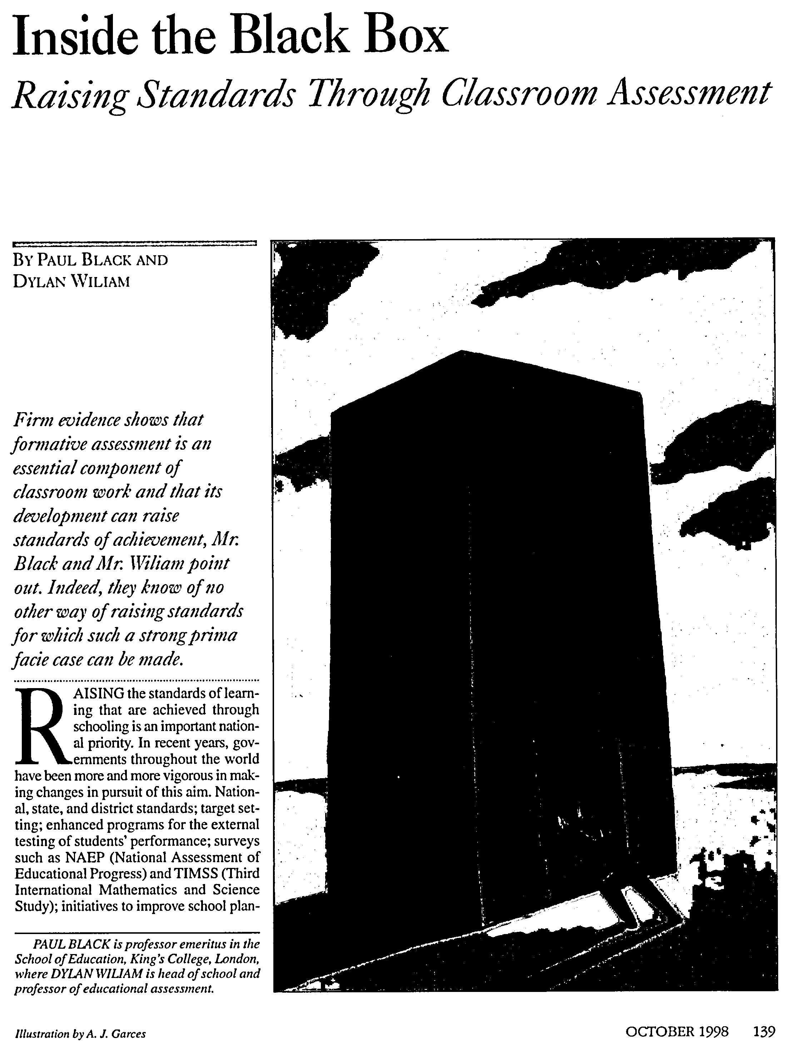
Inside the Black Box
by Paul Black and Dylan Wiliam, Phi Delta Kappan, copyright 1998 http://blog.discoveryeducation.com/assessment/files/2009/02/blackbox_article.pdf
Follow up research:
Working Inside the Black Box

Slide 12
Effective Formative Assessment Strategies
Clarifying learning intentions and sharing criteria for success
Engineering effective classroom discussions.
Providing feedback that moves learners forward.
Activating students as the owners of their own learning.
Activating students as instructional resources for one another.
Dylan Wiliam, University of London

Slide 13
Examine Student Work
Formative Assessment Cycle
Administer Tasks
Inform Teacher Knowledge
Inform Instruction

Slide 14
The Results from an Assessment
X
X
X
X
X
X
X
X
X
X
X
X
X
X
X
X
X
X
X
X
X
X
X
X
X
X
X
0
1
2
3
4
5
6
7
8
9
10
Students’ performances are across the continuum

Slide 15
Traditionally Teachers Choose One of Three Options
Go back and re-teach the topic with the entire class.
Identify the students needing remediation and find some time/opportunity to re-teach the topic while the rest of the class continues on.
Feeling the pressure of the over packed curriculum the teacher ventures on to the next topic.

Slide 16
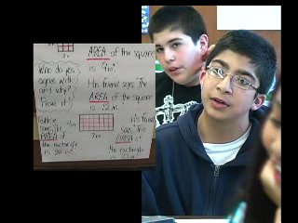
Re-engagement: Completing the Formative Assessment Cycle

Slide 17
MARS Tasks
Examine Student Work
Scoring and Student Works Protocols
Common Core Standards
Formative Assessment Cycle
Administer Tasks
Inform Teacher Knowledge
Re-engagement Lessons
Inform Instruction
Tools for Teachers and PD Materials

Slide 18
The MAC/MARS Math Performance Assessments
The Mathematics Assessment Resource Service (MARS) is an NSF funded collaboration between U.C. Berkeley, Michigan State and the Shell Centre in Nottingham England.
The Assessments target grades 2- Geometry and are aligned with the State and NCTM National Math Standards.

Slide 19
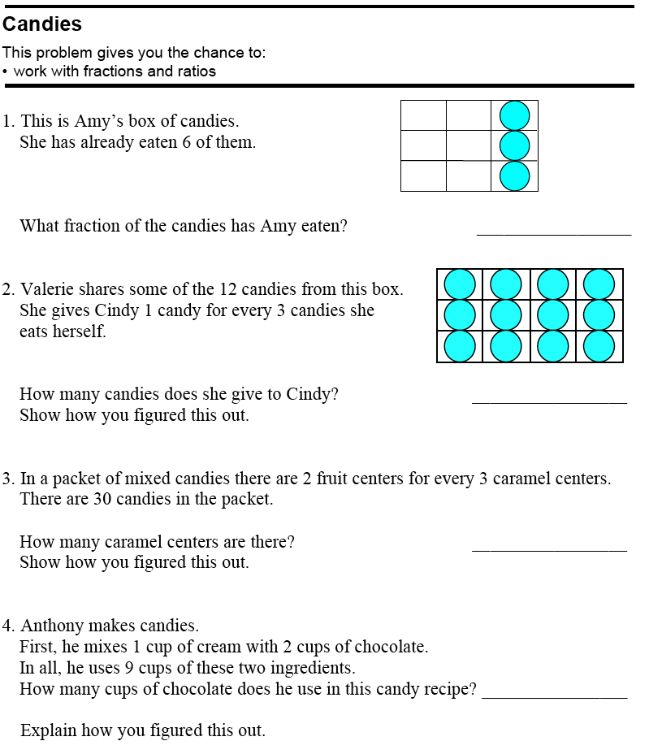

Slide 20
MARS Performance Assessments Task Design
Top
Entry level - (access into task)
Core Mathematics - (meeting standards)
Top of the Ramp - (conceptually deeper)
Core
Ramp
Access

Slide 21
Designing Re-engagement
The Mathematics Assessment Collaborative uses a process of formative assessment that use student work and assessment results to inform instruction and design lesson to re-engage students in learning the mathematics.

Slide 22
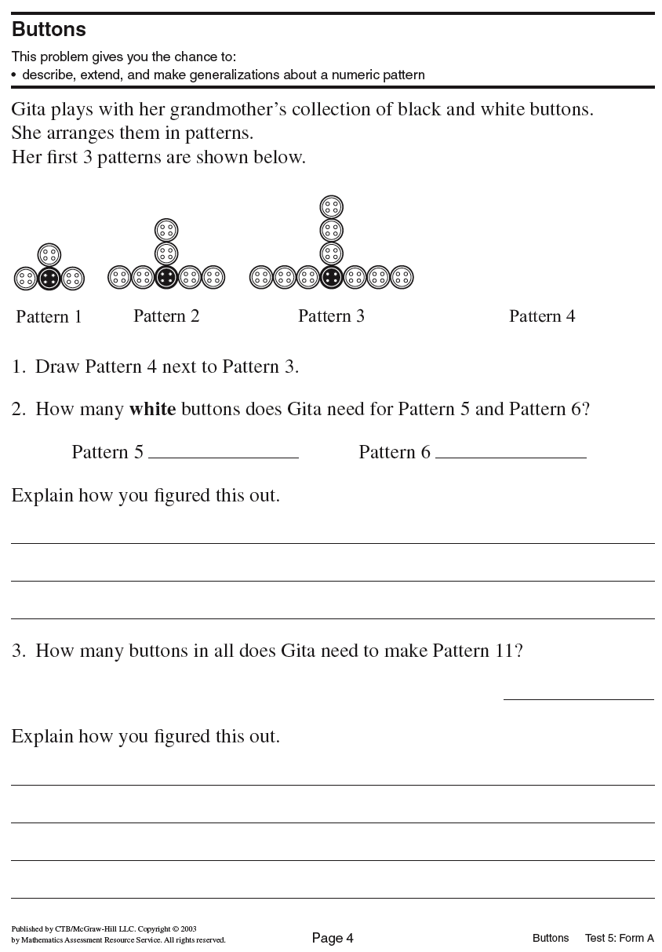

Slide 24
Examine Learner A’s Work
How is Learner A making sense of the mathematics?

Slide 25
Examine Learner B’s Work
How is Learner B making sense of the mathematics?

Slide 27
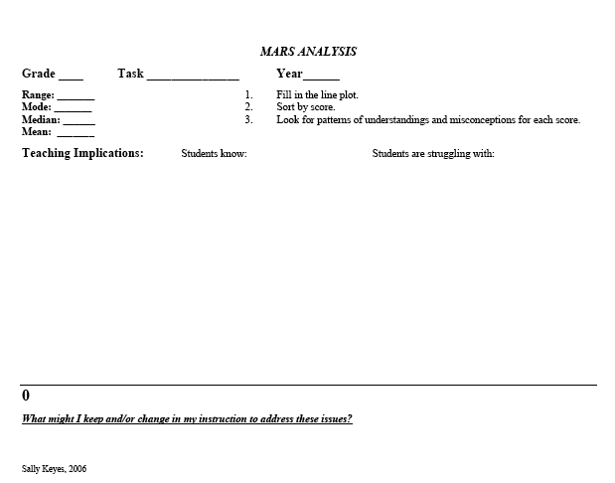
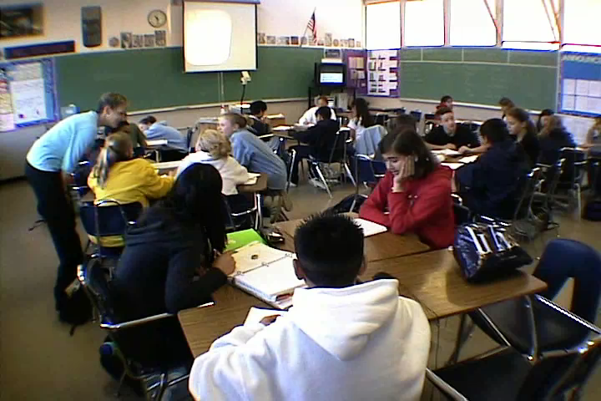
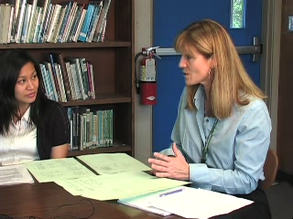
Collectively score and analyze student work
Administer high-quality assessment tasks
Cycle of Formative Assessment to Inform and Improve Learning
Document student thinking to inform instruction.
Leads to improved teaching and learning in the classroom (re-engagement)
Drives the professional development experiences of the teachers to plan experiences focused on their students.

Slide 28
Bell and Swan study

Slide 30
Re-teaching vs. Re-engagement
• Teach the unit again.
Revisit student thinking.
• Address basic skills that are missing.
• Address conceptual understanding.
• Do the same or similar problems over.
• Examine task from different perspective.
• Practice more to make sure student learn the procedures.
• Critique student approaches/solutions to make connections.
• Focus mostly on underachievers.
• The entire class is engaged in the math.
• Cognitive level is usually lower.
• Cognitive level is usually higher.

Slide 31
Teaching for Meaning

Slide 32
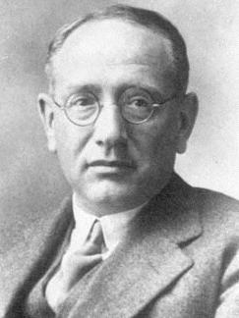
Mathematics, you see, is not a spectator sport. To understand mathematics means to be able to do mathematics. And what does it mean doing mathematics? In the first place it means to be able to solve mathematical problems.
George Polya, (1887 - 1985) Father of Problem Solving; “How to Solve It”, 1945

Slide 33
Why a Problem of the Month?
George Polya, said, “A problem is not a problem if you can solve it in 24 hours.”
Doing math is solving non-routine problems.
Perseverance and learning from mistakes are important attributes of good mathematicians.

Slide 34
How are the POM be used?
The POM are used school wide to promote problem solving.
Each problem is divided into five levels, A-E, to meet the learning development needs of all students.
A great tool for Differentiated Instruction.
Students, teachers and parents learn to ask questions and persevere in solving non-routine problems.
The whole school celebrates doing mathematics at school.

Slide 35
Problem of the Month
Party Time

Slide 36
Second Grade - Working on Party Time Level C

Slide 37
Level E A man and his wife invite 5 other couples to a dinner party. As the guests arrive for drinks before dinner, they shake hands. Not everybody shakes everybody's hands, and of course no one shakes hands with his own spouse. Later, as they sit down to dinner, the host asks each other person, including his wife, “how many hands you shake?” He notices, to his surprise, that each respondent shook a different number of hands. How many did his wife shake? Explain your solution and justify your reasoning.
Problem of the Month
Party Time

Slide 38
Gallery Walk for Party Time

Slide 40
Welcome to the Inside Mathematics Website
Welcome to Inside Mathematics, a professional resource for educators passionate about improving students' mathematics learning and performance.
This site features classroom examples of innovative teaching methods and insights into student learning, tools for mathematics instruction that teachers can use immediately, and video tours of the ideas and materials on the site.
Several allied initiatives dedicated to improving math teaching have contributed to this resource.
http://www.insidemathematics.org

Slide 41
"Don't be encumbered by history-- go off and do something wonderful."
Dr. Robert N. Noyce
Inventor of the Silicon Chip
Co-founder of Intel

