Slide 1
Common Core Mathematics Standards and Teacher Professional Development
Herb Clemens
Ohio State University

Slide 2
Common Core Mathematics Standards
…a very big deal!
…national standards for mathematics instruction for the first time in the history of the United States!
…we had better not screw it up!

Slide 3
Common Core Mathematics Standards
…a very big deal!
…a one-time opportunity for teachers to transform the status of their profession,
…they had better not screw it up!

Slide 4
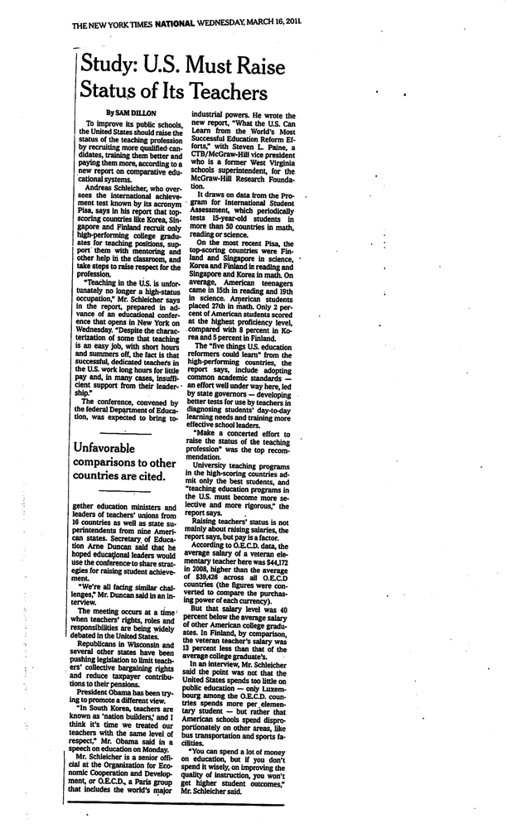
Professional status…
Comparisons…

Slide 5
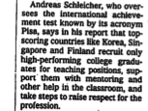
Word from PISA

Slide 6
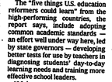
Five things…

Slide 7

…but the most important…

Slide 8
Who can raise the status of teachers?
In the end it is only the teachers themselves that can raise their professional status…
…their numbers are too big…
…and no other constituency has sufficient self-interest invested in the outcome…
…for it to be otherwise.

Slide 9
Other professions have transformed themselves…
…through their own education, professional development, and self-management of professional
Health professionals
Finance
Higher education

Slide 10
Components of career-long professional enhancement for university faculty
We continue to learn and generate new mathematics
We review our own work and that of our peers and colleagues
Through research and teaching, we become a resource for students, colleagues and the profession

Slide 11
Politics made this possible!
After the Second World War and Sputnik, society became convinced that they needed advanced mathematics and were willing to pay for it
The profession and our enablers (university administrations) took advantage of that perceived need

Slide 12
Career-long professional enhancement for mathematics teachers
Continue to learn/do mathematics
Continue to analyze teaching practice
Become a teaching resource for students, colleagues and the profession

Slide 13
Common Core gives teachers a political opportunity
Acceptance of the Common Core Standards by the sovereign States means that society is becoming convinced that they need high-quality mathematics teaching
Common Core Mathematics Standards will not be realized without highly professional mathematics teachers

Slide 14
Common Core gives teachers a political opportunity
An opportunity for teachers to achieve the status and command the necessary respect…
…so that society will adequately acknowledge and reward their profession

Slide 15
Can teachers do it alone?
No

Slide 16
“Outside” help
Professionally trained teacher-leaders
Laboratories of excellence
Superstars of the profession
Understanding the need for achievement and the need for access…
…but also recognizing that these two needs are different…

Slide 17
Professionally trained teacher-leaders
Boston University/EDC Masters program

Slide 18
Laboratories of excellence
Math for America
IAS/Park City Mathematics Institute
PROMYS for Teachers

Slide 19
Upcoming event
CBMS/MfA/PCMI national leadership workshop in July
How can we begin the process of raising the status of mathematics teachers?
Or rather, how can we begin the process of supporting mathematics teachers as they raise their own status?

