Slide 1
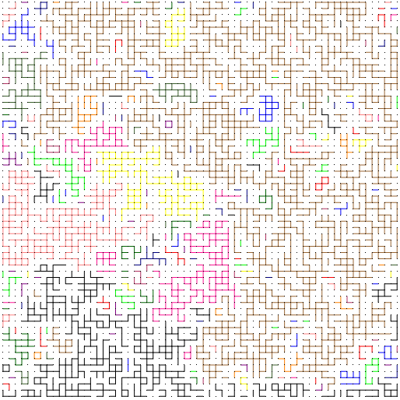
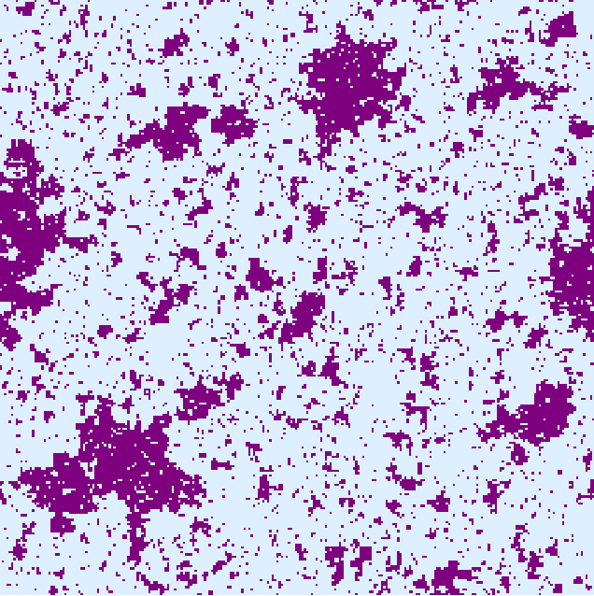
Glauber Dynamics for the Ising Model on the Square Lattice
Allan Sly
UC Berkeley
Joint work w. Eyal Lubetzky

Slide 2

Ising model
Underlying geometry: finite graph G=(V,E ) .
Set of possible configurations:
Probability of a configuration 
given by the Gibbs distribution
$μ\left(σ\right)=\frac{1}{Z}exp\left[β\sum_{u\sim v}{σ_{u}σ_{v}}\right]$
+
-
+
-
-
-
+
+
+
-
+
-
+
-
+
-
-
-
+
-
+
+
-
+
+

Slide 3
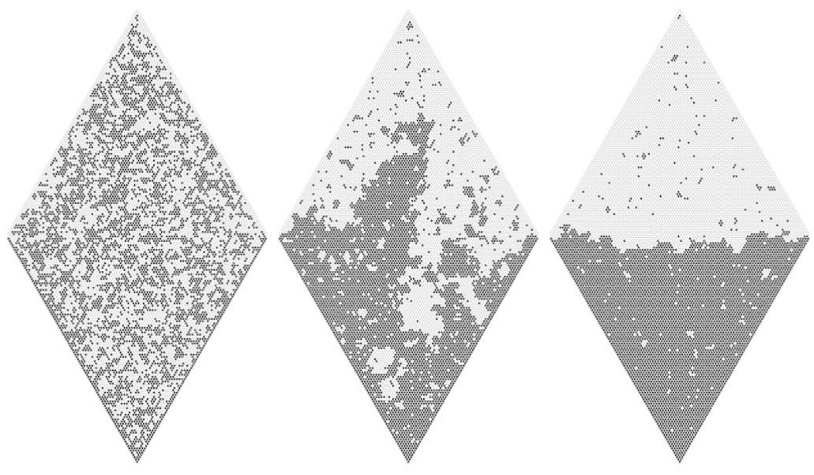
Phase Transition
High
Critical
Low
Image courtesy of David Wilson

Slide 4
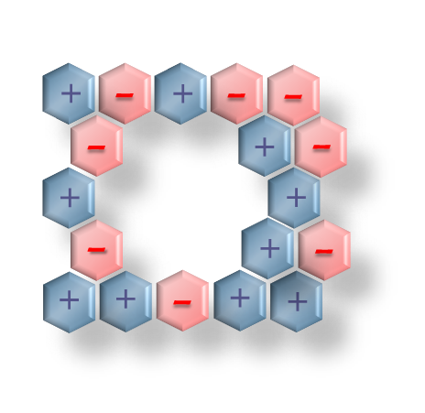
Glauber dynamics for Ising
One of the most commonly used MC samplers for the Gibbs distribution:
  Update sites via iid Poisson(1) clocks
  Each update replaces a spin at u V by
  a new one   conditioned on V u
  (heat-bath version).
Ergodic reversible MC with stationary measure .
How fast does it converge to equilibrium?
+
+
-
-
-
+
-
-

Slide 5

Rate of convergence to equilibrium
Spectral gap in the spectrum of the generator:
gap = smallest positive eigenvalue
the of heat-kernel H.
  Governs convergence in L²() .
Mixing time : standard measure of convergence:
  The L¹ (total-variation) mixing time within  is
  $t_{mix}\left(1/4\right)=\inf{\{t:\max_{x_{0}}{d_{TV}\left(μ, X_{t}\right)}<1/4\}}$

Slide 6
General (believed) picture for
Glauber dynamics
Setting: Ising model on the lattice (/n)^{d} .
Belief: For some critical inverse-temperature _{c} :
Low temperature: ( > _{c} )
gap⁻¹ and t_{mix} are exponential in the surface area.
Critical temperature: ( = _{c} )
gap⁻¹ and t_{mix} are polynomial in the surface area.
High temperature: ( < _{c} )
  Rapid mixing: gap^{–1} = O(1) and t_{mix}  log n
  Mixing occurs abruptly (cutoff phenomenon).

Slide 7
Mixing time for Ising on 2D lattices
Fast mixing for high temperatures:
    [Aizenman, Holley ’84]
    [Dobrushin, Shlosman ’87]
    [Holley, Stroock ’87, ’89]
    [Holley ’91]
    [Stroock, Zegarlinski ’92a, ’92b, ’92c]
    [Zegarlinski ’90, ’92]
    [Lu, Yau ’93]
    [Martinelli, Olivieri ’94a, ‘94b]
    [Martinelli, Olivieri, Schonmann ’94]
Slow Mixing for low temperatures:
        [Schonmann ’87],
        [Chayes, Chayes, Schonmann’87],
        [Martinelli ’94],
        [Cesi, Guadagni, Martinelli, Schonmann’96].

Slide 8
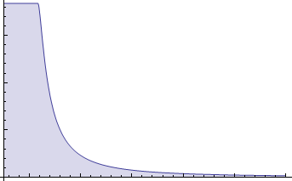

Mixing on the square lattice
High temperature: gap^{–1} is uniformly bounded,
O(log n) mixing for all  < _{c} = $\frac{1}{2}$log(1+$\sqrt{2}$) .
  [Martinelli, Olivieri ’94a, ‘94b]
  [Martinelli, Olivieri, Schonmann ’94]
Cutoff
  Cutoff with mixing time at $\frac{1}{λ_{∞}}\log{n}$ [Lubetzky, S. ‘09]:
cutoff

Slide 9

Low temperature
Low temperature: for  > _{c} both gap^{–1} and the mixing time are exp[(c()+o(1))n].
        [Chayes, Chayes, Schonmann’87],
        [Cesi, Guadagni, Martinelli, Schonmann’96].
  Theorem [Lubetzky, Martinelli, Toninelli, S. ‘10]:
Consider the low temperature, $β>β_{c}$, Ising model of side-length n. The mixing time of the Glauber dynamics under ‘plus’ boundary conditions is bounded above by $n^{c\log{n}}$.

Slide 10
Glauber dynamics at criticality
Polynomial lower bound on gap^{–1} via the polynomial decay of spin-spin correlation whose asymptotics were established by [Onsager ’44] ([cf. Holley ’91]).
Numerical experiments:  universal exponent of 2.17
  [Ito ’93], [Wang, Hatano, Suzuki ’95], [Grassberger ’95], [Nightingale, Blöte ’96], [Wang, Hu ’97],…
Compared to conjectured power-law behavior of gap^{–1} : No known sub-exponential upper bounds …
Only geometries with proved power-law for critical Ising:
  Mean-field [Levin, Luczak, Peres ’09] (Curie-Weiss model)
  Regular tree [Ding, Lubetzky, Peres ’10] (Bethe lattice).
?

Slide 11
Scaling limit of critical Ising
Understanding of the limit developed emerged with the advent of Schramm–Loewner evolution.
Recent breakthrough results due to
Smirnov describe full scaling limit
of cluster interfaces as SLE curves.
We use Russo-Seymour-Welsh type estimates for FK-Ising with arbitrary b.c.
    [Chelkak, Smirnov ‘09]
    [Camia, Newman ’09]
    [Duminil-Copin, Hongler, Nolin ’09]

Slide 12

Main result: power-law at criticality
Theorem [Lubetzky, S.]:
Corollary:
Polynomial total-variation mixing time under any fixed boundary condition.
Consider the critical Ising model on a finite box ☹  ² of side-length n. There exists an absolute constant C such that the spectral-gap of the Glauber dynamics under an arbitrary fixed boundary condition  is bounded by
$$n^{7/4}≤gap^{−1}≤n^{C}$$

Slide 13
Further bounds on critical gap
First polynomial upper bound for perfect simulation.
A new lower bound (previously known lower bound was nearly linear due to [Holley ’91]).
Theorem
The spectral-gap of the Glauber dynamics for critical Ising on a finite box ☹  ² of side-length n with arbitrary boundary condition  satisfies

Slide 14
Main techniques
Multi-scale estimates of the spectral gap.
Approach for analyzing high temperature dynamics:
  Control rate of mixing using exponential decay of correlation with distance.
At criticality there are long range correlations foiling this approach.
Alternative approach:
  Use RSW estimates to get a spatial-mixing result, combine it with classical ingredients from MC analysis.
  Analyze effect of an entire face of the boundary on spins
  (just enough spatial mixing to push this program through…)

Slide 15

Key spatial-mixing result
Theorem
Proof uses the RSW-estimate for critical crossing probabilities in a wired FK-Ising rectangle.
Let $B$ be rectangle of dimensions r,r  satisfying
r /r   > 0 with  fixed and let for some  satisfying    < r /r . Let ,  be two BC’s on ☹ that differ only on the bottom boundary . Then
Where  > 0 is a constant that depends only on  .

Slide 16

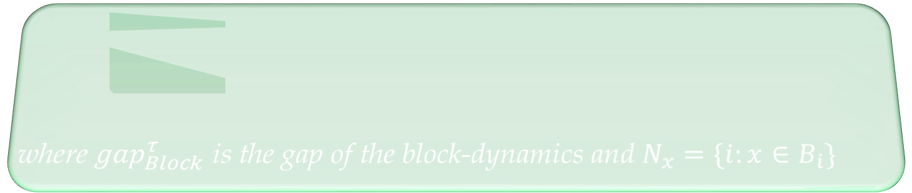
Single site vs. Block dynamics
Classical tool in the analysis of Glauber dynamics:
  Cover the sites using blocks  = {B_{i}}.
  Each block updates via a rate-1 Poisson clock.
  Updates are  stationary given the rest of the system.
Proposition (see, e.g. [Martinelli ’97]):
${\left(gap_{B}^{τ}\right)}^{−1}≤{\left(gap_{Block}^{τ}\right)}^{−1}\max_{η,i}{\left(gap_{B_{i}}^{τ}\right)}^{−1}\max{N_{x}}$
where $gap_{Block}^{τ}$ is the gap of the block-dynamics and $N_{x}=\{i:x∈B_{i}\}$

Slide 17

Upper bound via spatial-mixing
Partition the block B into $B_{1}$ and $B_{2}$ the top and bottom two thirds:
For any boundary condition  on ☹ we have
$${\left(gap_{Block}^{τ}\right)}^{−1}=O(1)$$
B₁
B₂

Slide 18

(ctd.)
Upper bound via spatial-mixing
The result is completed by induction on the block sizes.
Each application decreases the volume of the blocks by a factor of $\frac{2}{3}$at the cost of an absolute multiplicative constant in the gap.
Iterating 2log_{3/2}n steps completes the proof.

Slide 19
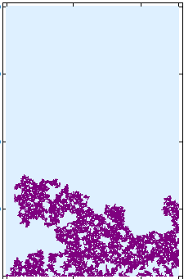
Intuition: spatial mixing proof
Compare the all plus b.c with b.c with plus on 3 sides, minus on the bottom
  Ising cluster adjacent to the bottom minus
  boundary converges to SLE₃ which
  does not climb past height r with
  positive probability.
  In that case, the measures can be coupled.
Actual setting:
  For induction we need the result for arbitrary boundary conditions.

Slide 20
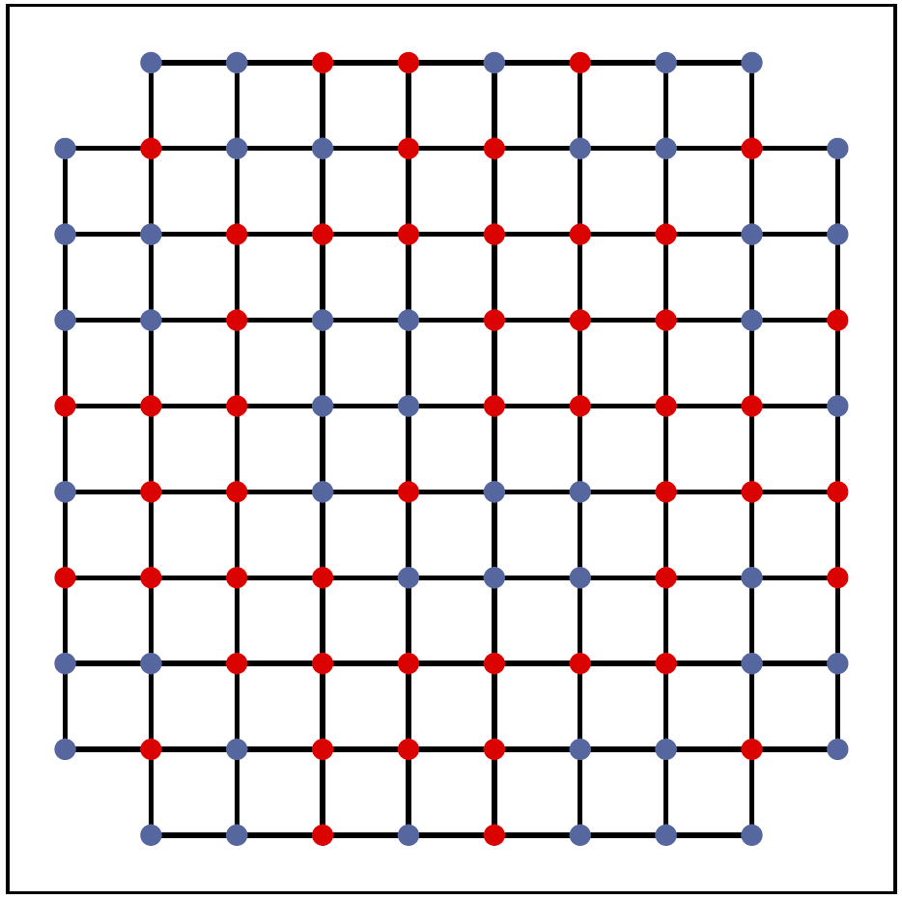
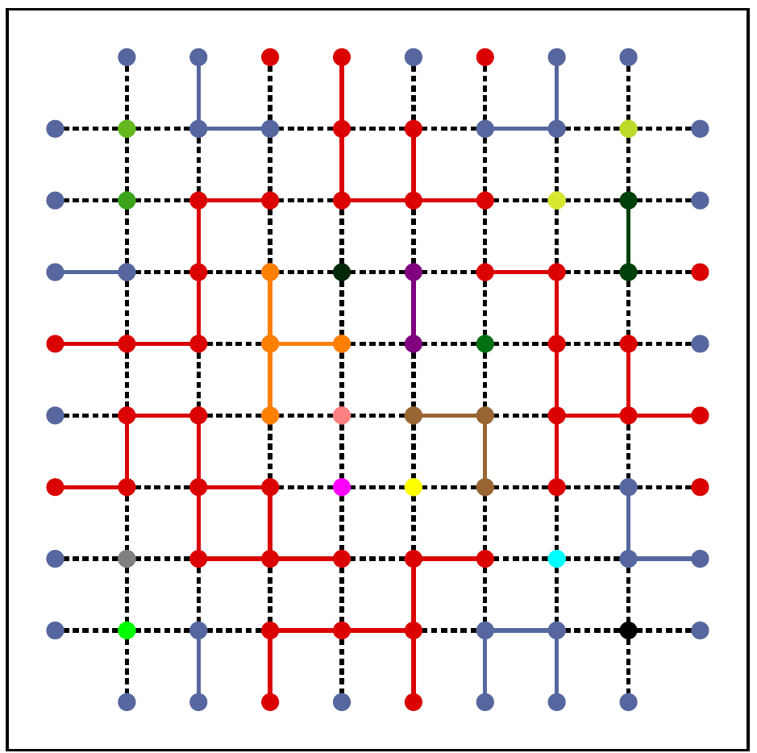
Solution: reduce to FK Ising
Ising and its FK counterpart are coupled by the Edwards-Sokal coupling:
  Under an arbitrary boundary condition  one can go from Ising to FK and back with conditioned on some event A which may have exponentially small probability…

Slide 21
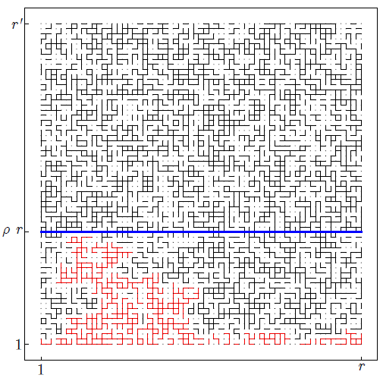
Completing the proof
Control crossing probabilities in the FK-Ising model conditioned on the event A .
Utilize the recent
RSW-type estimates
with the FKG for the
FK-model to derive
the required coupling.
Return to Ising via the
Edwards-Sokal method
to complete the proof.

Slide 22
Open problems
Calculate the precise (universal) critical dynamical exponent.
Establish power-law behavior on the lattice in higher dimensions.

Slide 23
Thank you.

