Slide 1
Promoting Teachers as Professionals: The Common Core Toolkit
MSRI: Teacher Education in View of the Common Core
Ellen Whitesides, University of Arizona
March 23, 2012
Slides © IM&E 2012

Slide 2
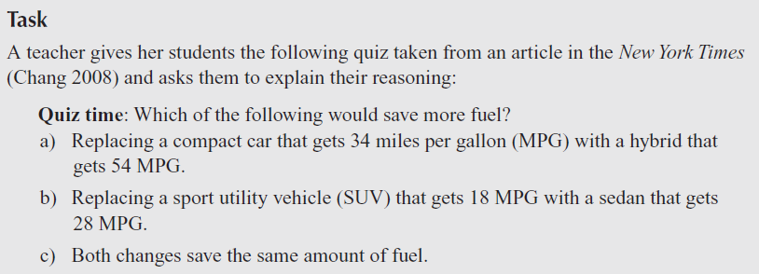
Starting off with some math from the high school toolkit…

Slide 3
Overview
Where did the idea come from?
What is the toolkit?
What has happened so far?
What is happening now?

Slide 4
CBMS ad hoc committee on Teachers as Professionals (c-TaP)
Achieve
American Federation of Teachers (AFT)
Association of State Supervisors of Mathematics (ASSM)
Association of Mathematics Teacher Educators (AMTE)
Conference Board of Mathematical Sciences (CBMS)
IAS/Park City Mathematics Institute (PCMI)
Institute for Mathematics & Education (IM&E)
Math for America
National Assessment Governing Board
National Council of Supervisors of Mathematics (NCSM)
National Council of Teachers of Mathematics (NCTM)
National Educational Association (NEA)

Slide 5
C-TaP Vision
Professionalize the teaching profession by encouraging teachers to take greater control.
Empower teachers to take charge of their profession, specifically the implementation of CCSSM.
“Mathematics teachers should have a leadership role in implementing the CCSSM from the beginning and that role should expand throughout the implementation.”
“a critical mass of mathematically knowledgeable teacher-leaders can be built as the engine for the implementation of CCSSM.”

Slide 6
First Step: Toolkit for Teacher Professional Development
Single day add-on to existing professional development for teachers at a specific grade band.
All the materials necessary to support the PD are developed and available to trained facilitators including videos, slides, handouts, activities, and facilitator notes.
States, districts, or schools that use the toolkit will be provided with the trained facilitators necessary to run the CCSSM focused day at a certain grade band.
Professional empower teachers to delve deeply into the standards and create their own PD, utilizing methods expected to be successful with their peers

Slide 7
Goals of the Toolkit
The toolkit will aim to address the following four goals:
See structure in the standards: progressions, ties, streams, and pinnacle standards.
Deeply explore the language used in the Common Core and understand this language in the context of different grade levels.
Understand the Standards for Mathematical Practice and see ways to implement them in the classroom.
Analyze classroom tasks for connections to the standards and see ways in which they can be adapted to the standards.
Keep the content focus of specific grade levels within the Common Core, and the importance of MPs living within content standards.

Slide 8
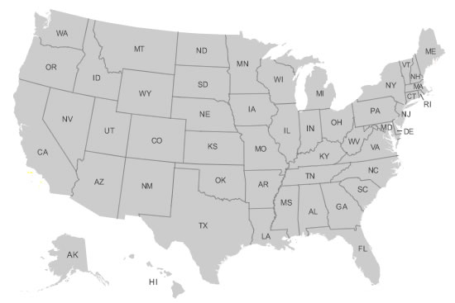
The authors

Slide 9
What has happened so far?
Teacher teams were selected for three grade bands from AFT, TUSD, and PCMI
Introductory workshop held in Tucson
Grade level teams worked independently to come up with activities addressing the goals
Teams returned to Tucson to present to a small group of teachers, district level PD facilitators, and mathematicians and received feedback
Groups incorporated feedback and c-TaP affiliated groups started testing activities

Slide 10
What is happening now?
Revisions on all three grade band toolkit drafts
Informal testing by c-TaP members with feedback to the authors
Training facilitators: May Conference
Summer PD
http://ime.math.arizona.edu/2011-12/betatoolkit.html
Summer revisions at PCMI

Slide 11
The Elementary Toolkit
Goal 1: Understand the overall goals of the Common Core State Standards for Mathematics.
Goal 2: Understand the eight Standards of Mathematical Practice that span grade levels
Goal 3: Understand the structure and progression of the standards across grades and domains
Goal 4: Understand the specific language used in the standards
Goal 5: Develop the ability to analyze and categorize a task as demonstrating a certain standard(s)
Goal 6: Become aware of resources available to help understand and implement the CCSM

Slide 12
Mental Math Video
Beginning of the year in a third grade class
Goal 1: Understand the overall goals of the Common Core State Standards for Mathematics.

Slide 13
The Elementary Toolkit
Goal 4: Understand the specific language used in the standards
Use the strategies of Composing and Decomposing:
K.OA. 3. Decompose numbers less than or equal to 10 into pairs in more than one way, e.g., by using objects or drawings, and record each decomposition by a drawing or equation (e.g., 5 = 2 + 3 and 5 = 4 + 1).
1.OA.6. Add and subtract within 20, demonstrating fluency for addition and subtraction within 10. Use strategies such as counting on; making ten (e.g., 8 + 6 = 8 + 2 + 4 = 10 + 4 = 14); decomposing a number leading to a ten (e.g., 13 – 4 = 13 – 3 – 1 = 10 – 1 = 9); using the relationship between addition and subtraction (e.g., knowing that 8 + 4 = 12, one knows
12 – 8 = 4); and creating equivalent but easier or known sums (e.g., adding 6 + 7 by creating the known equivalent 6 + 6 + 1 = 12 + 1 = 13).

Slide 14
The Middle School Toolkit
Video for MPs
Match tasks to standards that they illustrate –
Focusing on the RP progression and standards in the EE, RP, and Geometry Domains in 6-8th grade.

Slide 15
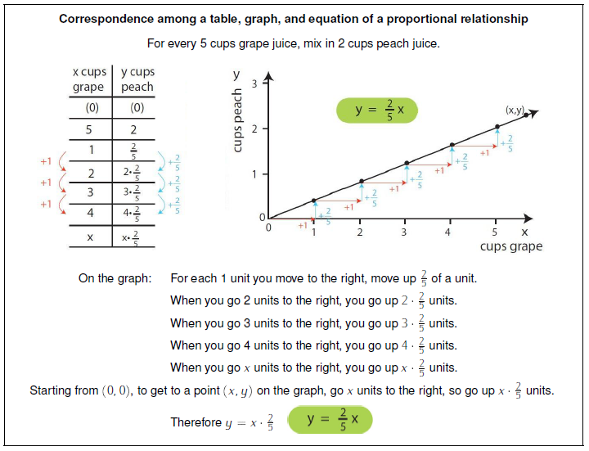
The Middle School Toolkit

Slide 16
The High School Toolkit
Identify, value, and nurture the Mathematical Practices in student work and discourse
Use the language and structure of the CCSS to guide your teaching and assessment
Develop efficient and effective ways to integrate the CCSS into your daily practice
See implementing the CCSS in your practice as achievable and important to do

Slide 17
The High School Toolkit
Statistics Activity
Geometry Activity
Fuel Savings

Slide 18
The MPs are everywhere in the content standards

